Slide 1
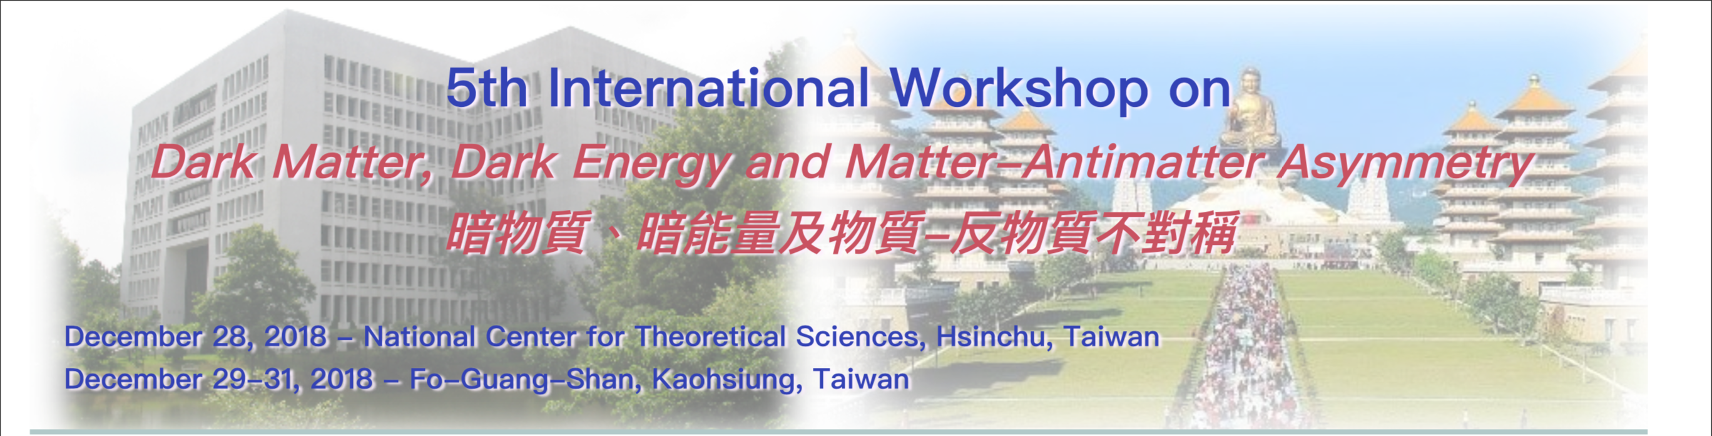

Dark Matter Direct Detections
Name : Chun-Hao Lee (NTHU)
Advisor : Prof. Dr. Chao-Qiang Geng
Chao-Qiang Geng, Da Huang, Chun-Hao Lee, and Qing Wang, “Direct Detection of Exothermic Dark Matter with a Light Mediator.”, JCAP 1608, 009 (2016).
Chao-Qiang Geng, Da Huang, Chun-Hao Lee, “Exothermic Dark Matter with Light Mediator after LUX and PandaX-II in 2016”,
Phys. Dark Univ. 18 38-46 (2017).

Slide 2

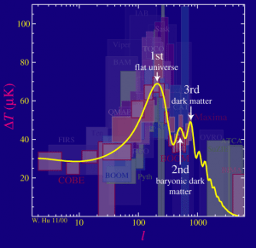
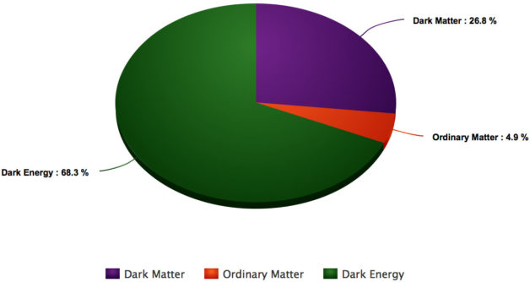
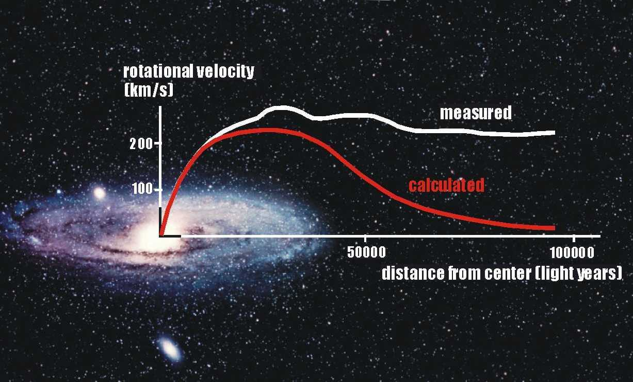
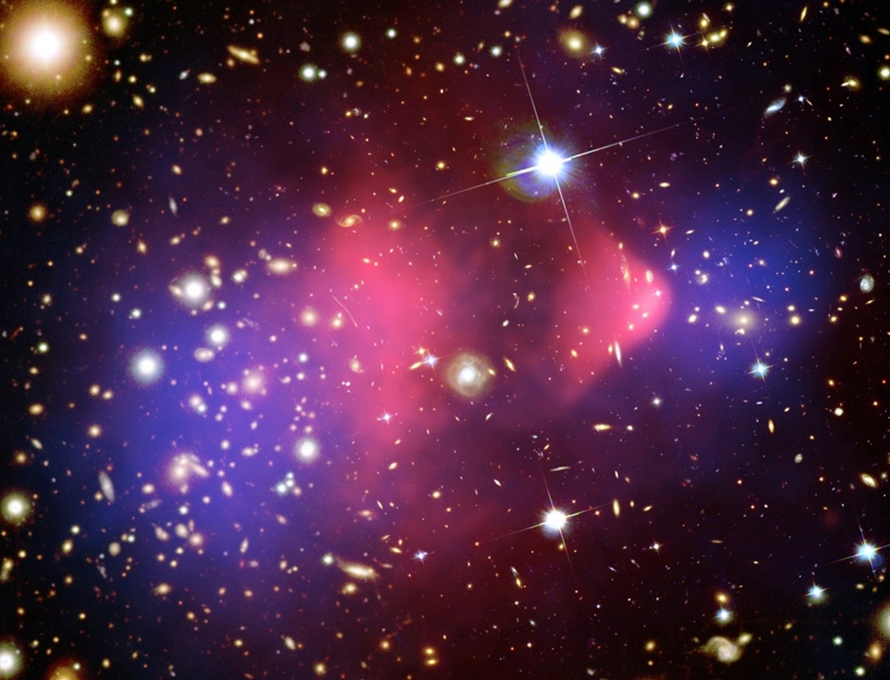
Introduction
5th International Workshop on Dark Matter, Dark Energy and Matter-Antimatter Asymmetry, 28/12/2018~1/1/2019
Fluctuations of CMB spectrum
Dark Matter
Dark Matter
Bullet Cluster
Constant Rotation Curve

Slide 3
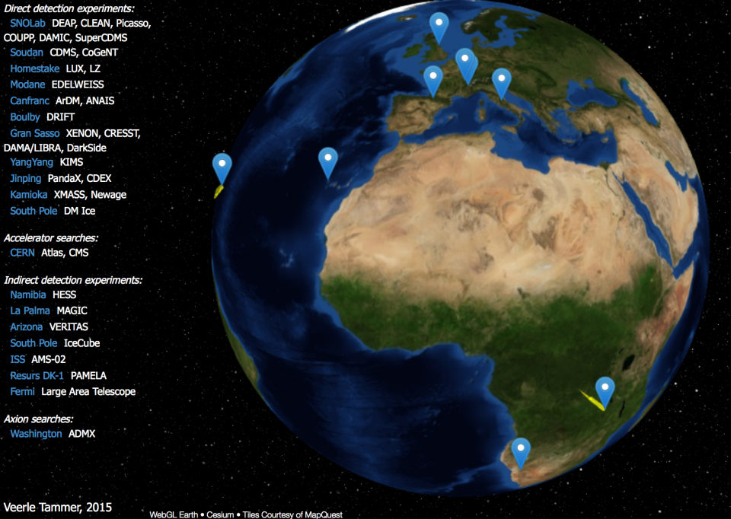
Introduction
Identification of Dark Matter
  Dark Matter related experiments around the world

Slide 4
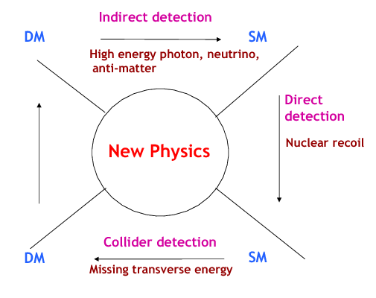
Introduction
Identification of Dark Matter
  Dark Matter related experiments around the world
Measure the recoil energy deposited by the interaction of a WIMP particle with a nucleus in the detector

Slide 5
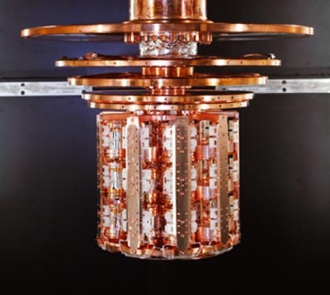
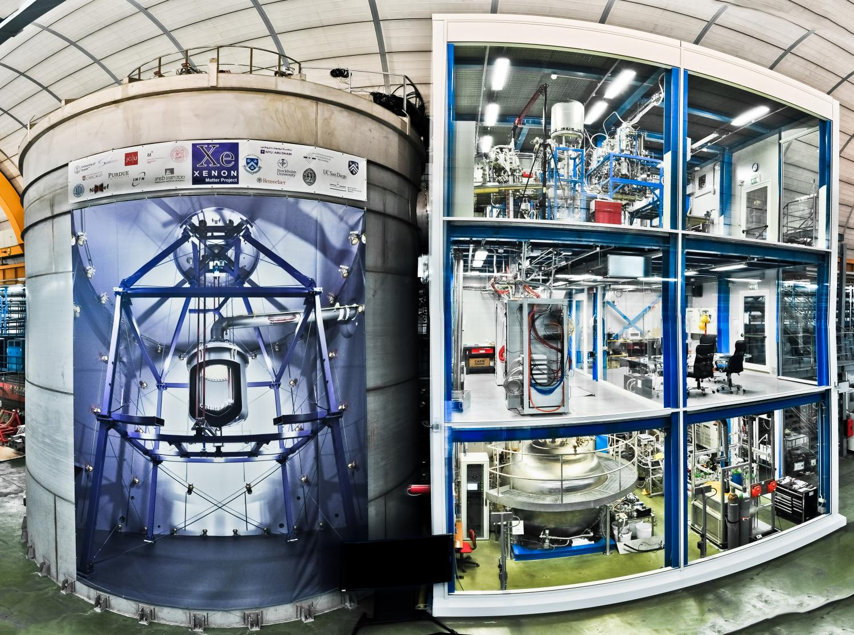
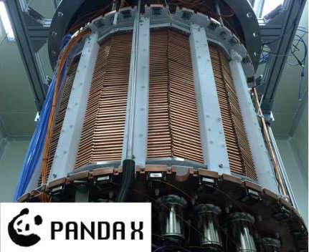
Introduction
5th International Workshop on Dark Matter, Dark Energy and Matter-Antimatter Asymmetry, 28/12/2018~1/1/2019
  DAMA,
  CoGeNT,
  CDMS-Si
  CDEX,
  SuperCDMS,
  CDMSlite,
  XENON 10 & 100,
  LUX (2013, 2015, 2016),
  PandaX-II
  PICO-60
  XENON1T (2017)
Positive signals for light WIMPs
Null results

Slide 6
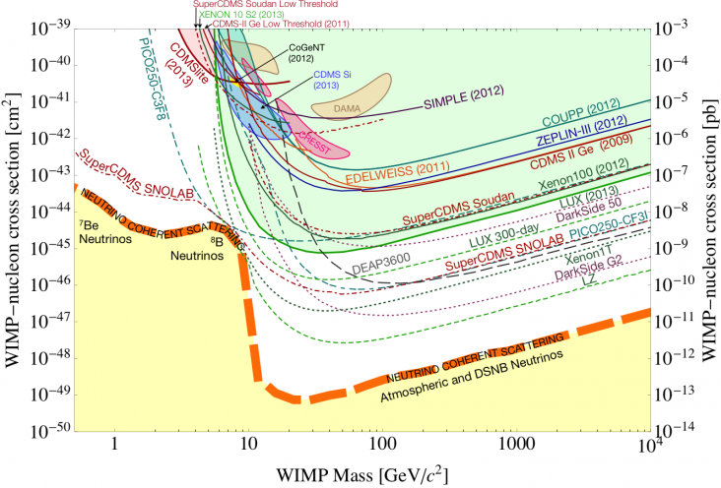
Introduction
5th International Workshop on Dark Matter, Dark Energy and Matter-Antimatter Asymmetry, 28/12/2018~1/1/2019
Motivation of this work:
Significant conflict between the signal regions and the exclusion limits
  Most of the signal regions had been excluded

Slide 7
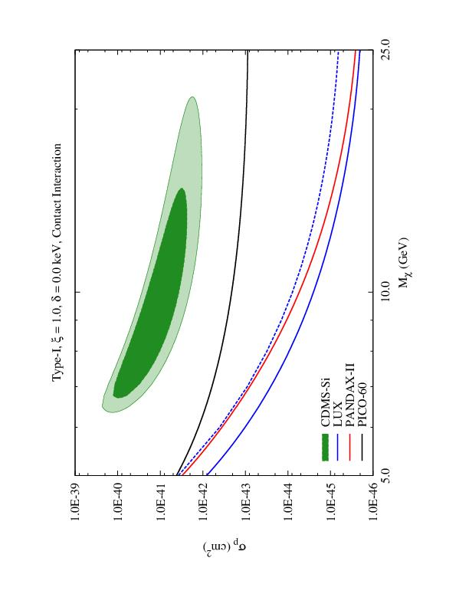
Introduction
5th International Workshop on Dark Matter, Dark Energy and Matter-Antimatter Asymmetry, 28/12/2018~1/1/2019
In the present study:
  Focus on the CDMS-Si’s signal region, and LUX’s, PandaX-II’s, PICO-60’s and XENON1T’s exclusion limits

Slide 8
General Framework
5th International Workshop on Dark Matter, Dark Energy and Matter-Antimatter Asymmetry, 28/12/2018~1/1/2019
Dark matter models:
  Choice of target nuclei and the technique employed to detect DM is unique to each experiment
  Comparison of results from different experiments requires the specification of an underlying model that determines the interaction between a WIMP and a nucleus
  A change of the model could alter the expected event rate and the nuclear recoil energy spectrum of different experiments
  Modifying the nature of WIMP-nucleus interaction could also modified the nuclear recoil energy spectrum and thus, changing the sensitivity of those experiments

Slide 9
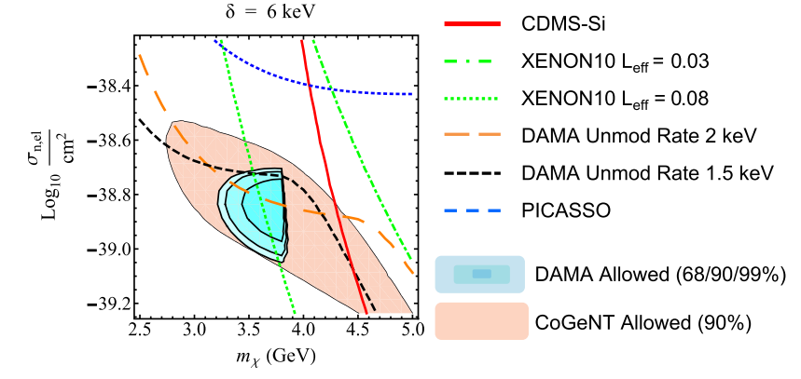
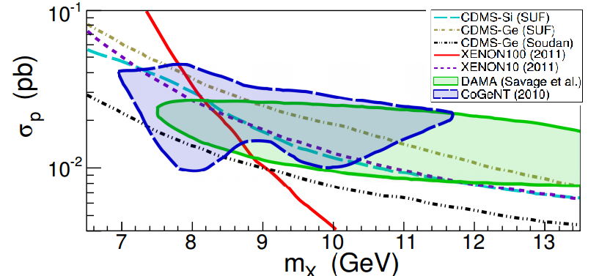
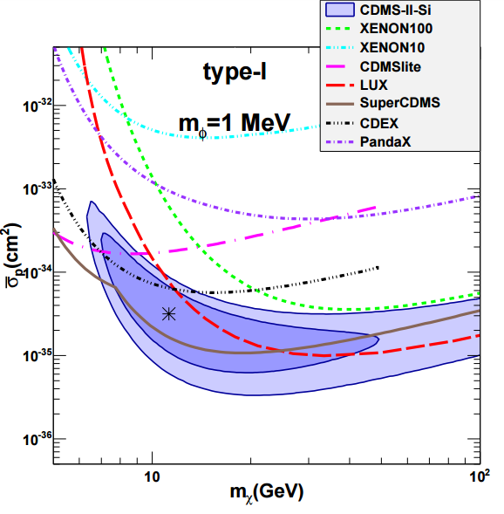
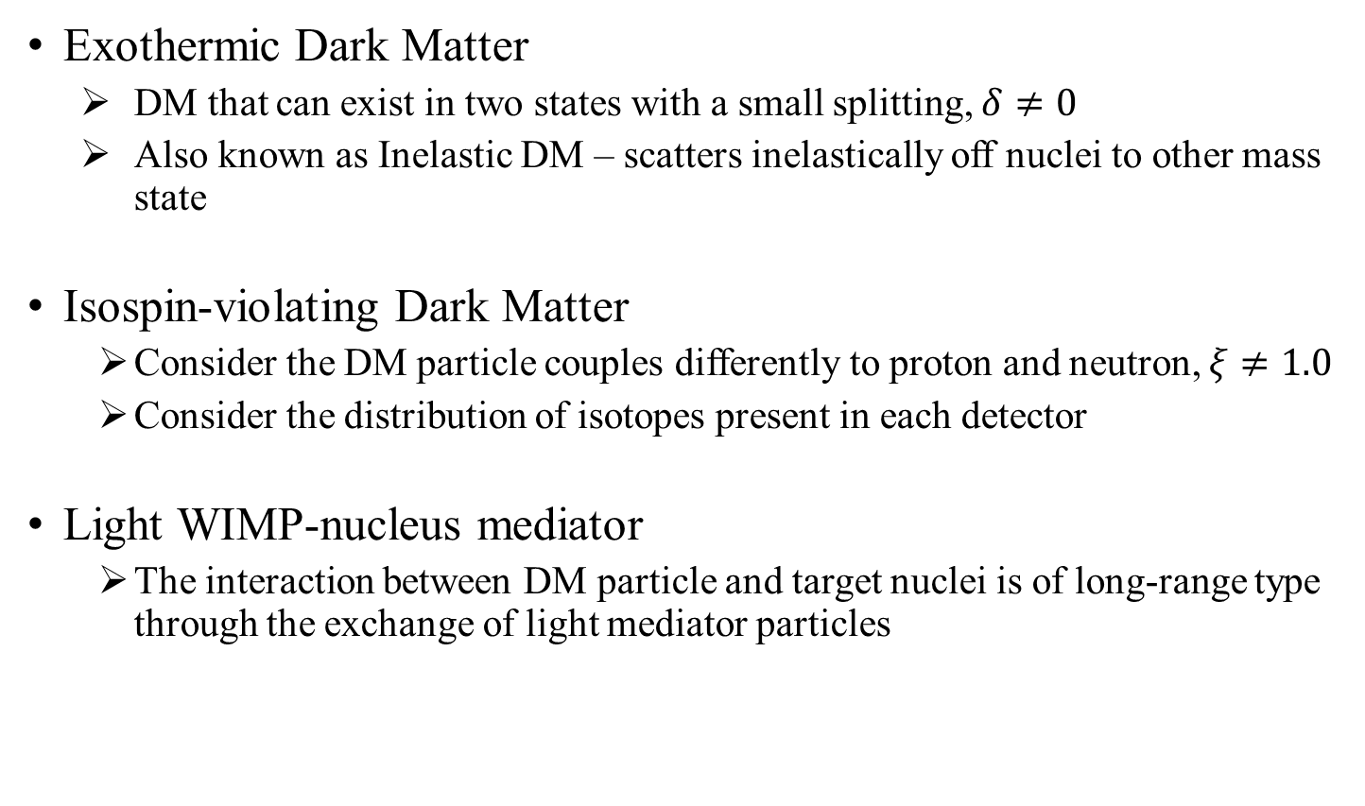
General Framework
5th International Workshop on Dark Matter, Dark Energy and Matter-Antimatter Asymmetry, 28/12/2018~1/1/2019
Exothermic Dark Matter
  DM that can exist in two states with a small splitting, $δ≠0$
  Also known as Inelastic DM – scatters inelastically off nuclei to other mass state
Isospin-violating Dark Matter
  Consider the DM particle couples differently to proton and neutron, $ξ≠1.0$
  Consider the distribution of isotopes present in each detector
Light WIMP-nucleus mediator
  The interaction between DM particle and target nuclei is of long-range type through the exchange of light mediator particles
W. G. Peter et al., Physics Review D 82, 063512 (2010)
J. L. Feng et al., Physics Letters B, 703(2011) 124-127
T. Li et al., JCAP, 1503(2015) 032
None of these models with single mechanism could survive the exclusion of LUX 2013 dataset & SuperCDMS 2014 dataset

Slide 10
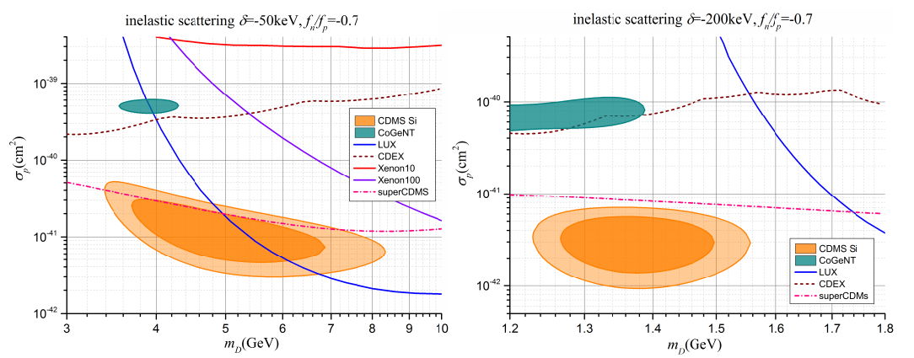
General Framework
5th International Workshop on Dark Matter, Dark Energy and Matter-Antimatter Asymmetry, 28/12/2018~1/1/2019
After LUX 2013 & SuperCDMS 2014, new models with different combinations of mechanisms:
  Exothermic DM with Isospin Violation
Nan Chen et al., Phys. Lett. B 743, 205 (2015)

Slide 11
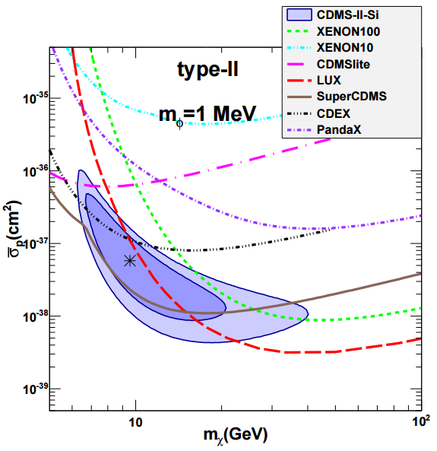
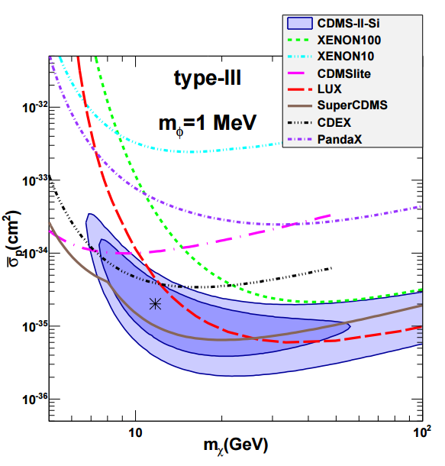
General Framework
5th International Workshop on Dark Matter, Dark Energy and Matter-Antimatter Asymmetry, 28/12/2018~1/1/2019
  Elastic DM with Light Mediator and Isospin Violation
L. Tai, M. Sen, and Y. F. Zhou , JCAP 1503 (2015)

Slide 12
General Framework
5th International Workshop on Dark Matter, Dark Energy and Matter-Antimatter Asymmetry, 28/12/2018~1/1/2019
New models proposed in the present study:
  Isospin-conserving Exothermic DM with Light Mediator (Combination of two mechanisms that have never been considered before)
  Isospin-violating Exothermic DM with light mediator (Combination of three mechanisms)

Slide 13
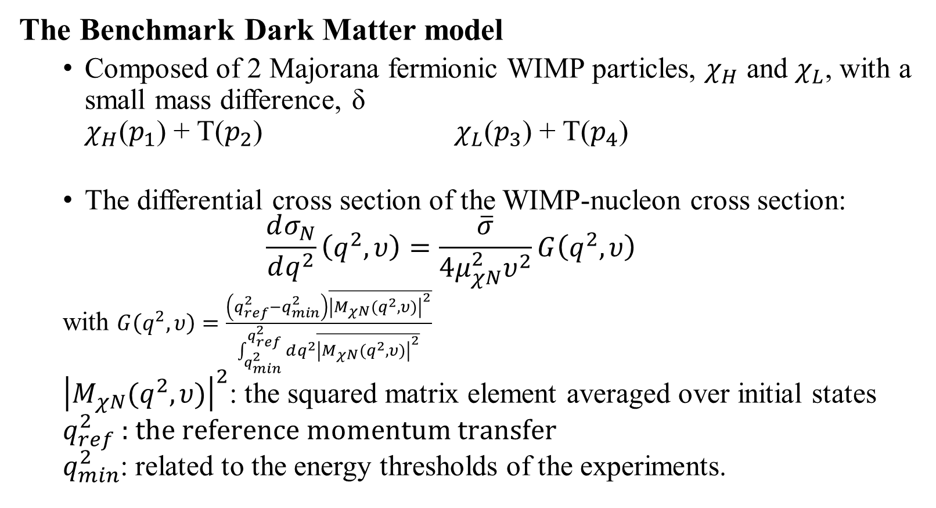
General Framework
5th International Workshop on Dark Matter, Dark Energy and Matter-Antimatter Asymmetry, 28/12/2018~1/1/2019
The Benchmark Dark Matter model
  Composed of 2 Majorana fermionic WIMP particles, $χ_{H}$ and $χ_{L}$, with a small mass difference, δ
  $χ_{H}$($p_{1}$) + T($p_{2}$) $χ_{L}$($p_{3}$) + T($p_{4}$)
  The differential cross section of the WIMP-nucleon cross section:
  $$\frac{dσ_{N}}{dq^{2}}\left(q^{2},υ\right)=\frac{\overline{σ}}{4μ_{χN}^{2}υ^{2}}G\left(q^{2},υ\right)$$
  with $G\left(q^{2},υ\right)=\frac{\left(q_{ref}^{2}−q_{min}^{2}\right)\overline{{\left|M_{χN}(q^{2},υ)\right|}^{2}}}{\int_{q_{min}^{2}}^{q_{ref}^{2}}{dq^{2}\overline{{\left|M_{χN}(q^{2},υ)\right|}^{2}}}}$
  ${\left|M_{χN}(q^{2},υ)\right|}^{2}$: the squared matrix element averaged over initial states
  $q_{ref}^{2}$ : $the reference momentum transfer$
  $q_{min}^{2}$: related to the energy thresholds of the experiments.
Cross section defined at a reference velocity
Reduced mass of the WIMP-nucleon system

Slide 14
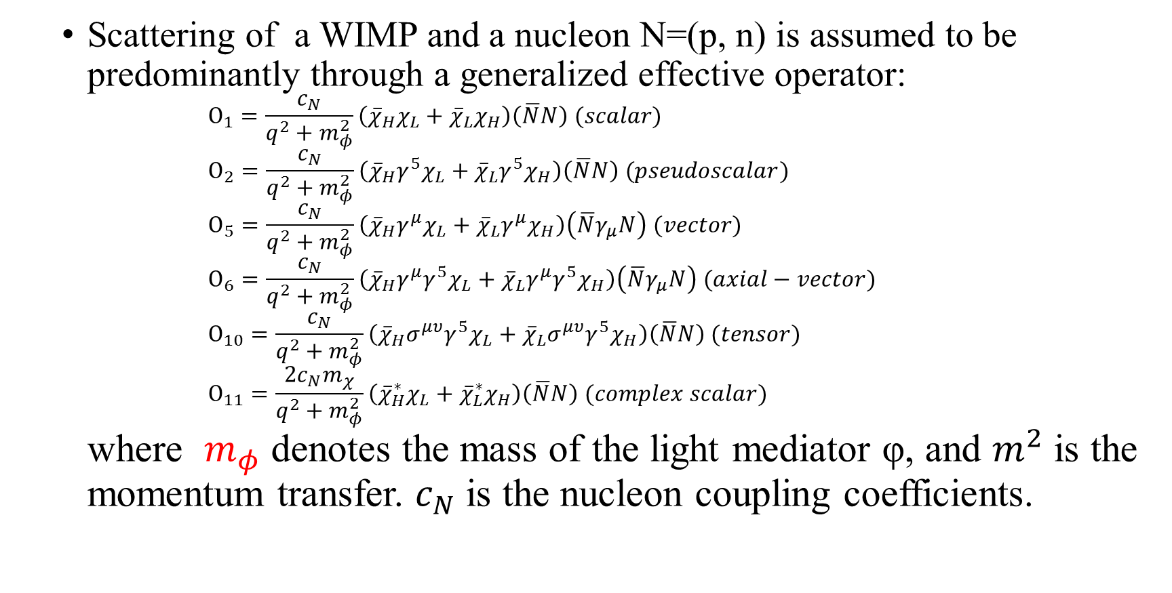
General Framework
5th International Workshop on Dark Matter, Dark Energy and Matter-Antimatter Asymmetry, 28/12/2018~1/1/2019
  Scattering of a WIMP and a nucleon N=(p, n) is assumed to be predominantly through a generalized effective operator:
  $Ο_{1}=\frac{c_{N}}{q^{2}+m_{φ}^{2}}\left({\overline{χ}}_{H}χ_{L}+{\overline{χ}}_{L}χ_{H}\right)\left(\overline{N}N\right) (scalar)$
  $Ο_{2}=\frac{c_{N}}{q^{2}+m_{φ}^{2}}\left({\overline{χ}}_{H}γ^{5}χ_{L}+{\overline{χ}}_{L}γ^{5}χ_{H}\right)\left(\overline{N}N\right) (pseudoscalar)$
  $Ο_{5}=\frac{c_{N}}{q^{2}+m_{φ}^{2}}\left({\overline{χ}}_{H}γ^{μ}χ_{L}+{\overline{χ}}_{L}γ^{μ}χ_{H}\right)\left(\overline{N}γ_{μ}N\right) (vector)$
  $Ο_{6}=\frac{c_{N}}{q^{2}+m_{φ}^{2}}\left({\overline{χ}}_{H}γ^{μ}{γ^{5}χ}_{L}+{\overline{χ}}_{L}γ^{μ}{γ^{5}χ}_{H}\right)\left(\overline{N}γ_{μ}N\right) (axial−vector)$
  $Ο_{10}=\frac{c_{N}}{q^{2}+m_{φ}^{2}}\left({\overline{χ}}_{H}σ^{μυ}{γ^{5}χ}_{L}+{\overline{χ}}_{L}σ^{μυ}{γ^{5}χ}_{H}\right)\left(\overline{N}N\right) (tensor)$
  $Ο_{11}=\frac{{2c}_{N}m_{χ}}{q^{2}+m_{φ}^{2}}\left({\overline{χ}}_{H}^{∗}χ_{L}+{\overline{χ}}_{L}^{∗}χ_{H}\right)\left(\overline{N}N\right) (complex scalar)$
  where $m_{φ}$ denotes the mass of the light mediator φ, and $m^{2}$ is the momentum transfer. $c_{N}$ is the nucleon coupling coefficients.

Slide 15

General Framework
5th International Workshop on Dark Matter, Dark Energy and Matter-Antimatter Asymmetry, 28/12/2018~1/1/2019
Different types of operators:
  Type-I :
  $Ο_{1}=\frac{c_{N}}{q^{2}+m_{φ}^{2}}\left({\overline{χ}}_{H}χ_{L}+{\overline{χ}}_{L}χ_{H}\right)\left(\overline{N}N\right)$
  $Ο_{5}=\frac{c_{N}}{q^{2}+m_{φ}^{2}}\left({\overline{χ}}_{H}γ^{μ}χ_{L}+{\overline{χ}}_{L}γ^{μ}χ_{H}\right)\left(\overline{N}γ_{μ}N\right)$
  $Ο_{11}=\frac{{2c}_{N}m_{χ}}{q^{2}+m_{φ}^{2}}\left({\overline{χ}}_{H}^{∗}χ_{L}+{\overline{χ}}_{L}^{∗}χ_{H}\right)\left(\overline{N}N\right)$
  Type-II :
  $Ο_{2}=\frac{c_{N}}{q^{2}+m_{φ}^{2}}\left({\overline{χ}}_{H}γ^{5}χ_{L}+{\overline{χ}}_{L}γ^{5}χ_{H}\right)\left(\overline{N}N\right)$
  $Ο_{10}=\frac{c_{N}}{q^{2}+m_{φ}^{2}}\left({\overline{χ}}_{H}σ^{μυ}{γ^{5}χ}_{L}+{\overline{χ}}_{L}σ^{μυ}{γ^{5}χ}_{H}\right)\left(\overline{N}N\right)$
  Type-III :
  $Ο_{6}=\frac{c_{N}}{q^{2}+m_{φ}^{2}}\left({\overline{χ}}_{H}γ^{μ}{γ^{5}χ}_{L}+{\overline{χ}}_{L}γ^{μ}{γ^{5}χ}_{H}\right)\left(\overline{N}γ_{μ}N\right)$

Slide 16
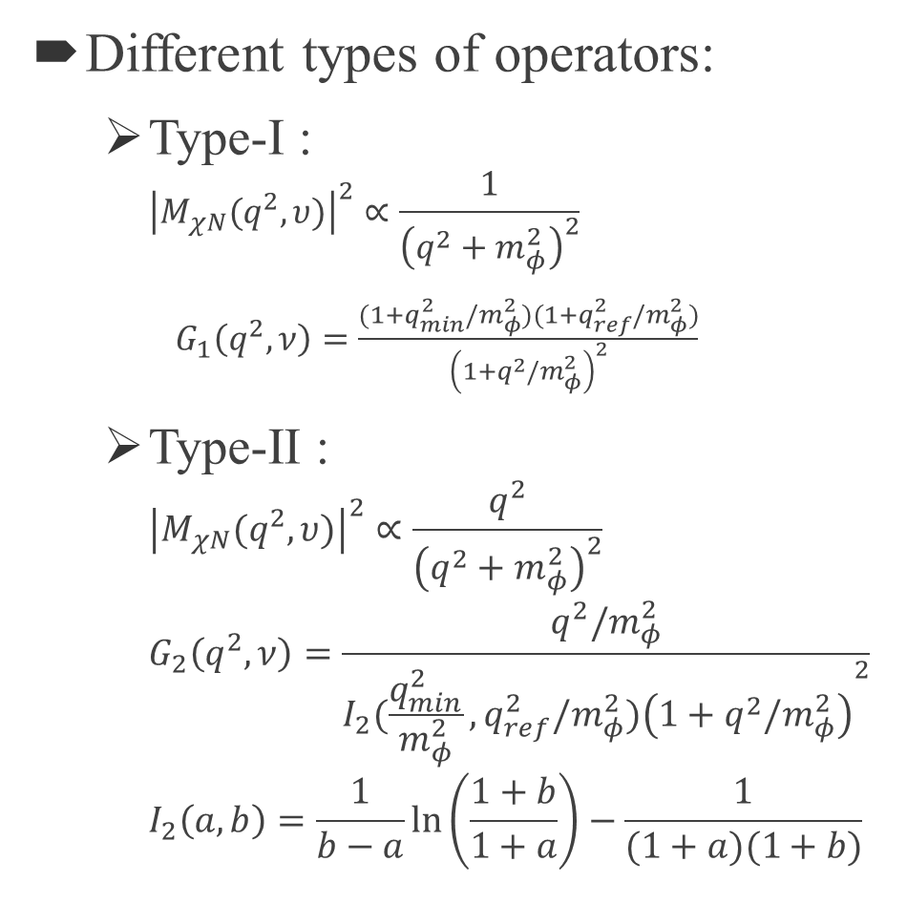
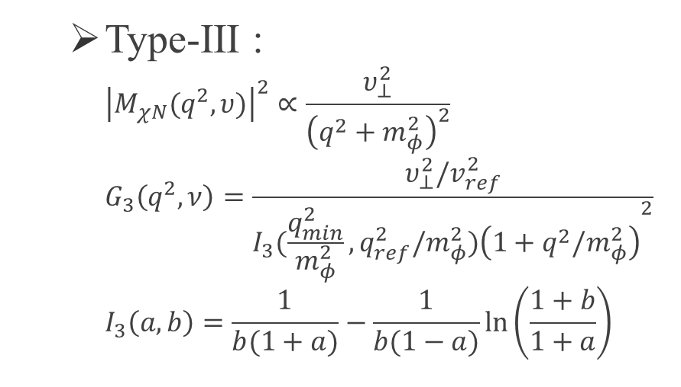
General Framework
5th International Workshop on Dark Matter, Dark Energy and Matter-Antimatter Asymmetry, 28/12/2018~1/1/2019
Different types of operators:
  Type-I :
  ${\left|M_{χN}(q^{2},υ)\right|}^{2}∝\frac{1}{{\left(q^{2}+m_{φ}^{2}\right)}^{2}}$
  $G_{1}\left(q^{2},ν\right)=\frac{(1+q_{min}^{2}/m_{φ}^{2})(1+q_{ref}^{2}/m_{φ}^{2})}{{\left(1+q^{2}/m_{φ}^{2}\right)}^{2}}$
  Type-II :
  ${\left|M_{χN}(q^{2},υ)\right|}^{2}∝\frac{q^{2}}{{\left(q^{2}+m_{φ}^{2}\right)}^{2}}$
  $G_{2}\left(q^{2},ν\right)=\frac{q^{2}/m_{φ}^{2}}{{I_{2}(\frac{q_{min}^{2}}{m_{φ}^{2}},q_{ref}^{2}/m_{φ}^{2})\left(1+q^{2}/m_{φ}^{2}\right)}^{2}}$
  $I_{2}\left(a,b\right)=\frac{1}{b−a}\ln\left(\frac{1+b}{1+a}\right)−\frac{1}{(1+a)(1+b)}$
  Type-III :
  ${\left|M_{χN}(q^{2},υ)\right|}^{2}∝\frac{υ_{⊥}^{2}}{{\left(q^{2}+m_{φ}^{2}\right)}^{2}}$
  $G_{3}\left(q^{2},ν\right)=\frac{υ_{⊥}^{2}/v_{ref}^{2}}{{I_{3}(\frac{q_{min}^{2}}{m_{φ}^{2}},q_{ref}^{2}/m_{φ}^{2})\left(1+q^{2}/m_{φ}^{2}\right)}^{2}}$
  $I_{3}\left(a,b\right)=\frac{1}{b(1+a)}−\frac{1}{b(1−a)}\ln\left(\frac{1+b}{1+a}\right)$

Slide 17
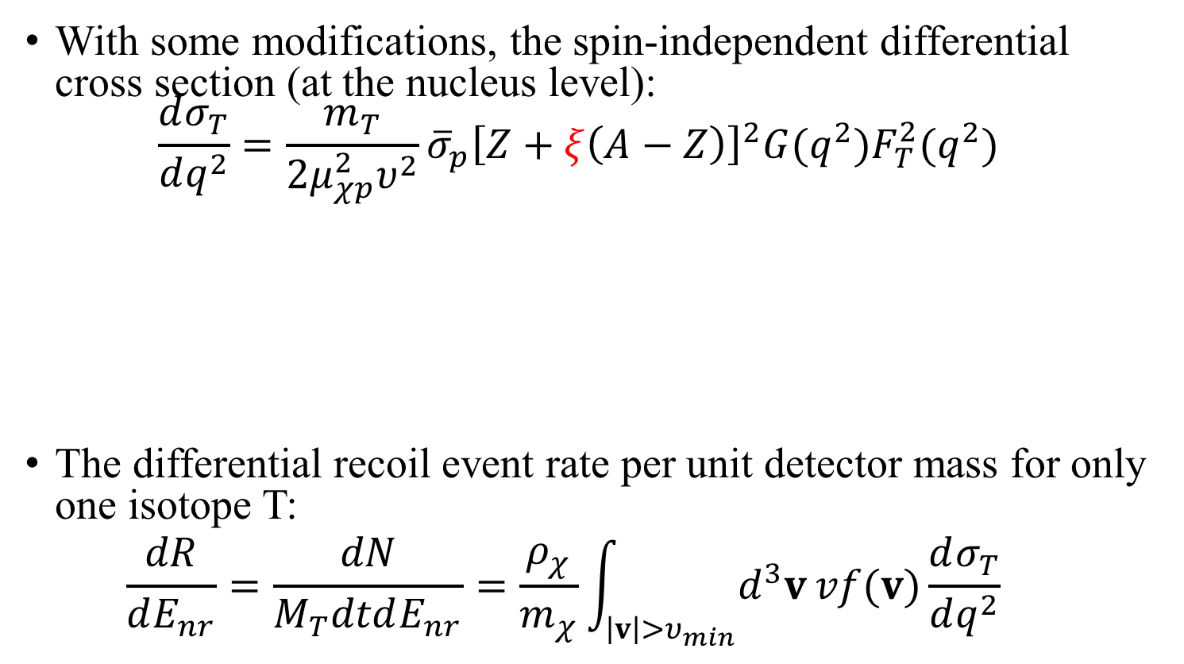

General Framework
5th International Workshop on Dark Matter, Dark Energy and Matter-Antimatter Asymmetry, 28/12/2018~1/1/2019
With some modifications, the spin-independent differential cross section (at the nucleus level):
$\frac{dσ_{T}}{dq^{2}}=\frac{m_{T}}{2μ_{χp}^{2}υ^{2}}{\overline{σ}}_{p}{\left[Z+ξ\left(A−Z\right)\right]}^{2}G(q^{2})F_{T}^{2}(q^{2})$
The differential recoil event rate per unit detector mass for only one isotope T:
  $$\frac{dR}{dE_{nr}}=\frac{dN}{M_{T}dtdE_{nr}}=\frac{ρ_{χ}}{m_{χ}}\int_{\left|v\right|>υ_{min}}{d^{3}v}vf(v)\frac{dσ_{T}}{dq^{2}}$$
$$\frac{c_{n}}{c_{p}}$$
Atomic mass number
Atomic number
Nuclear Form Factor
(Helm form)
Local DM energy density
Galactic DM velocity distribution (lab frame)

Slide 18
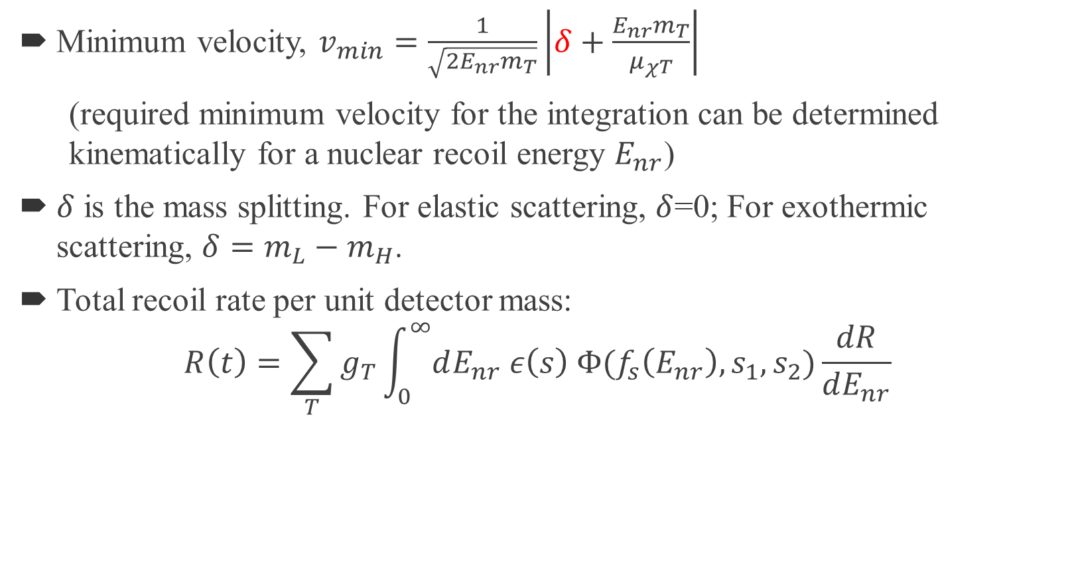
General Framework
5th International Workshop on Dark Matter, Dark Energy and Matter-Antimatter Asymmetry, 28/12/2018~1/1/2019
Minimum velocity, $v_{min}=\frac{1}{\sqrt{2E_{nr}m_{T}}}\left|δ+\frac{E_{nr}m_{T}}{μ_{χT}}\right|$
  (required minimum velocity for the integration can be determined kinematically for a nuclear recoil energy $E_{nr}$)
$δ$ is the mass splitting. For elastic scattering, $δ$=0; For exothermic scattering, $δ=m_{L}−m_{H}$.
Total recoil rate per unit detector mass:
$$R\left(t\right)=\sum_{T}{g_{T}\int_{0}^{∞}{dE_{nr} ε\left(s\right) Φ(f_{s}\left(E_{nr}\right),s_{1},s_{2})}}\frac{dR}{dE_{nr}}$$
Mass fraction of each target nuclide
Detector Efficiency
Response function

Slide 19
Fitting Results
5th International Workshop on Dark Matter, Dark Energy and Matter-Antimatter Asymmetry, 28/12/2018~1/1/2019
Isospin-Conserving Elastic Contact Interactions
Exothermic Dark Matter with Isospin-Violating Couplings
Xe-phobic Dark Matter with a Light Mediator
Exothermic Dark Matter with a Light Mediator
Exothermic Dark Matter with a Light Mediator and Isospin-Violation

Slide 20
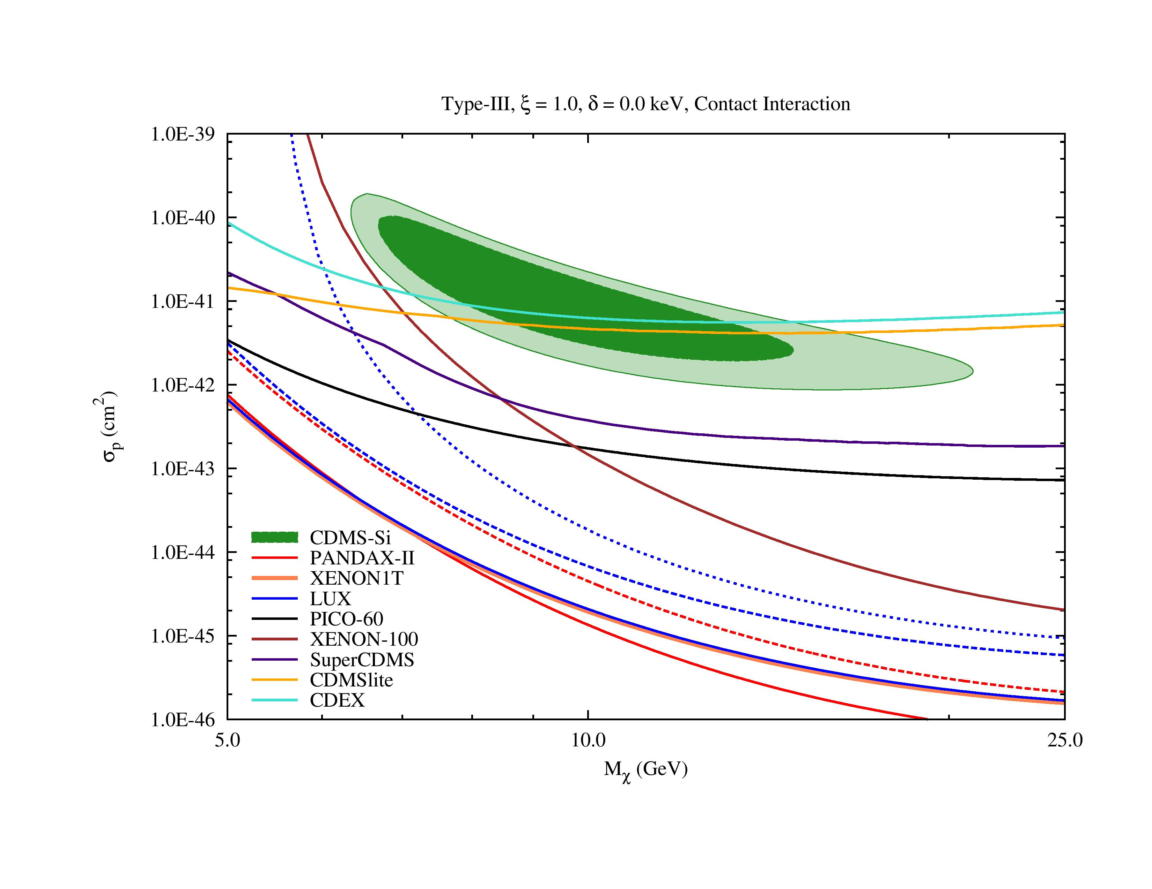
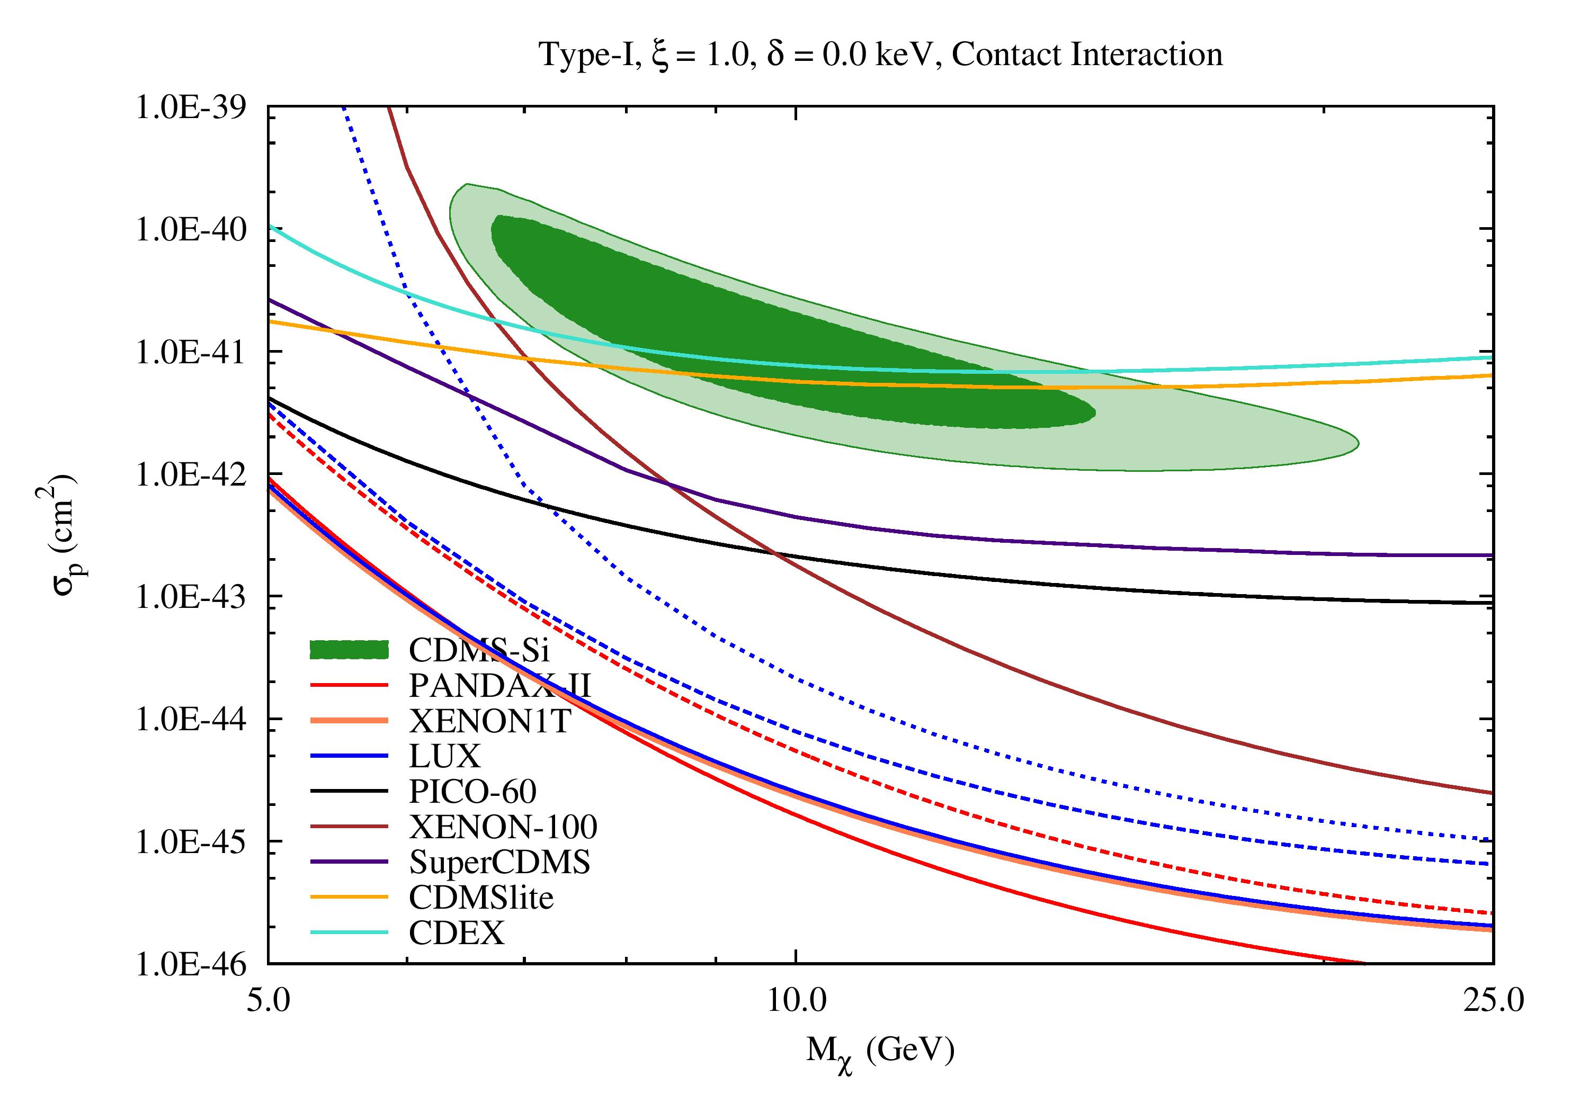
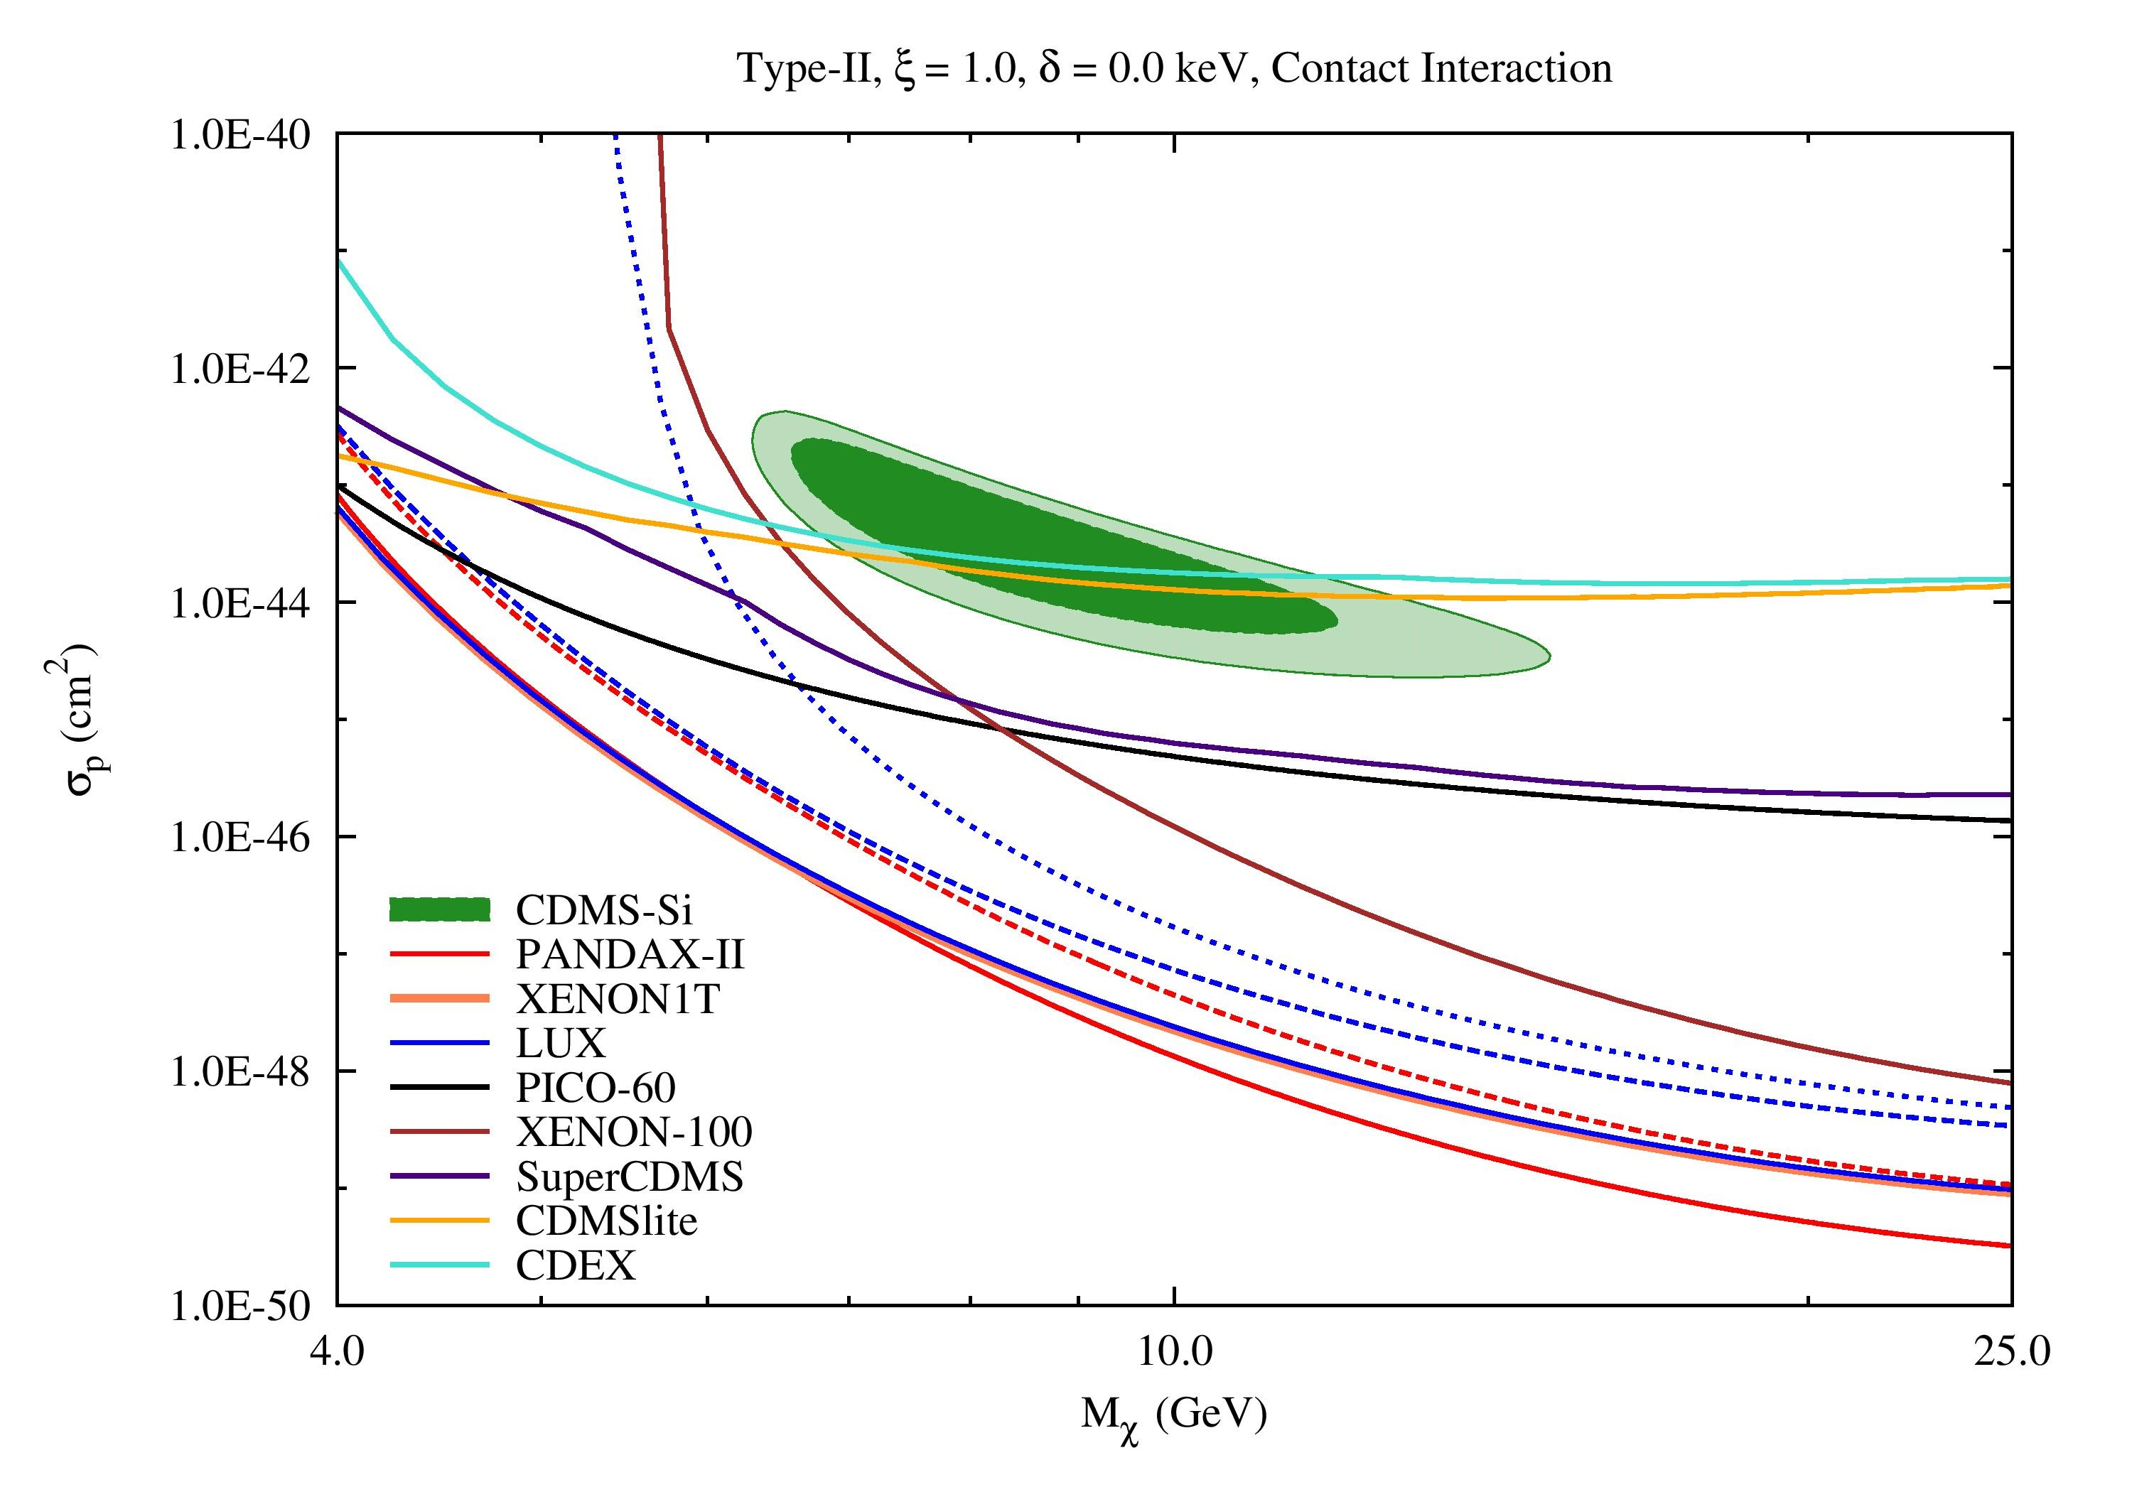
Fitting Results
5th International Workshop on Dark Matter, Dark Energy and Matter-Antimatter Asymmetry, 28/12/2018~1/1/2019
Isospin-Conserving Elastic Contact Interactions

Slide 21
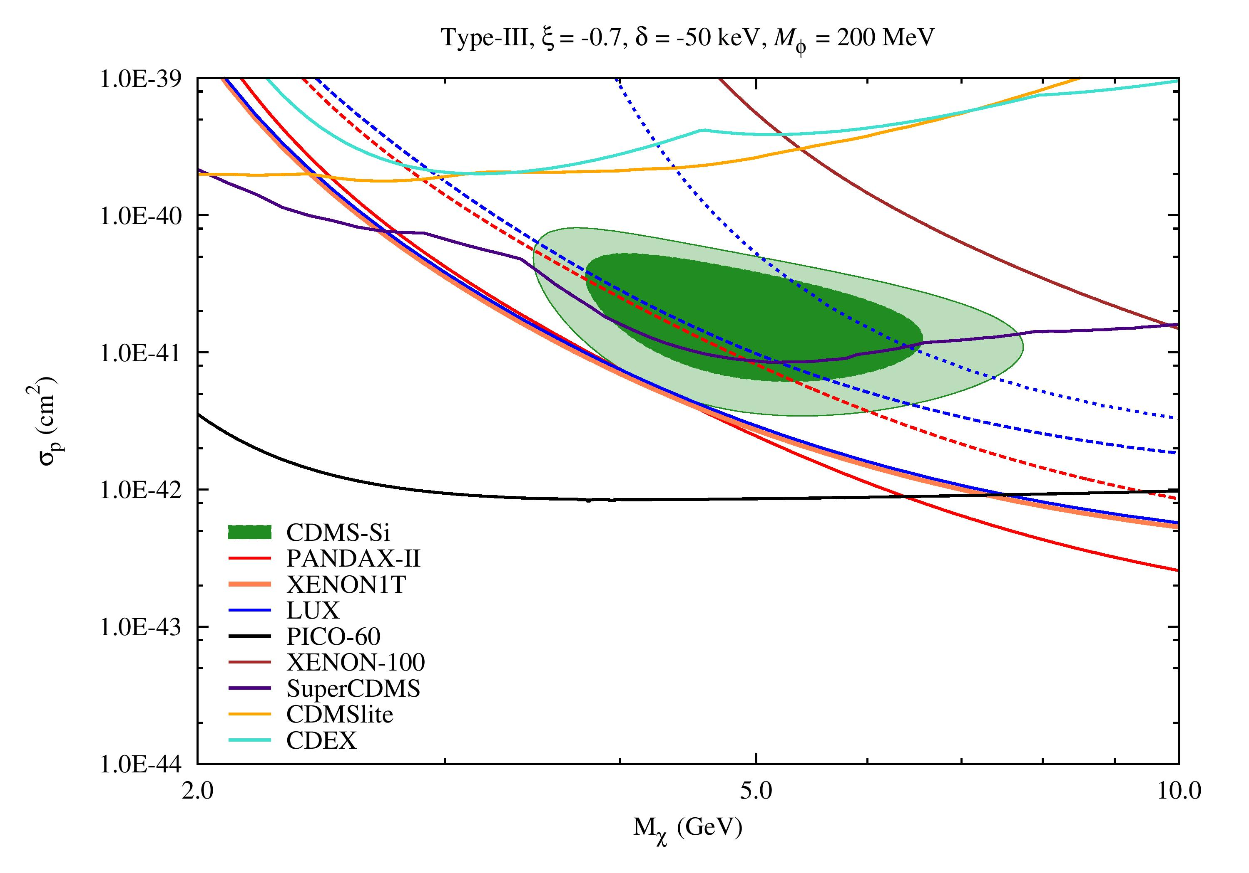
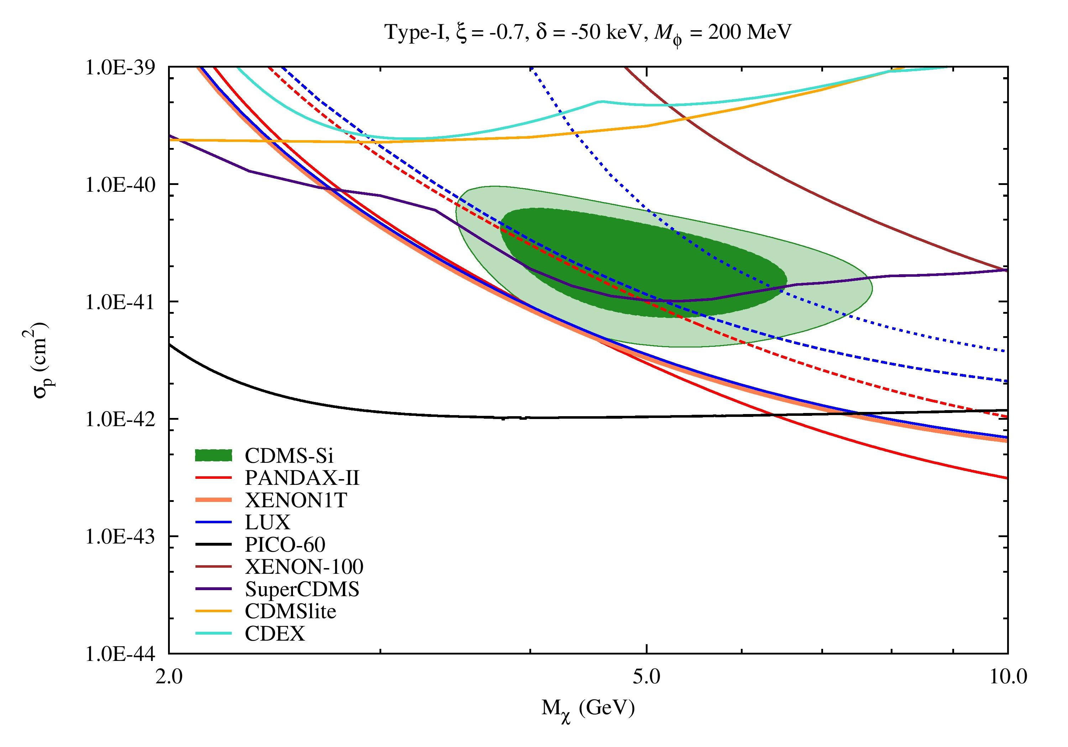
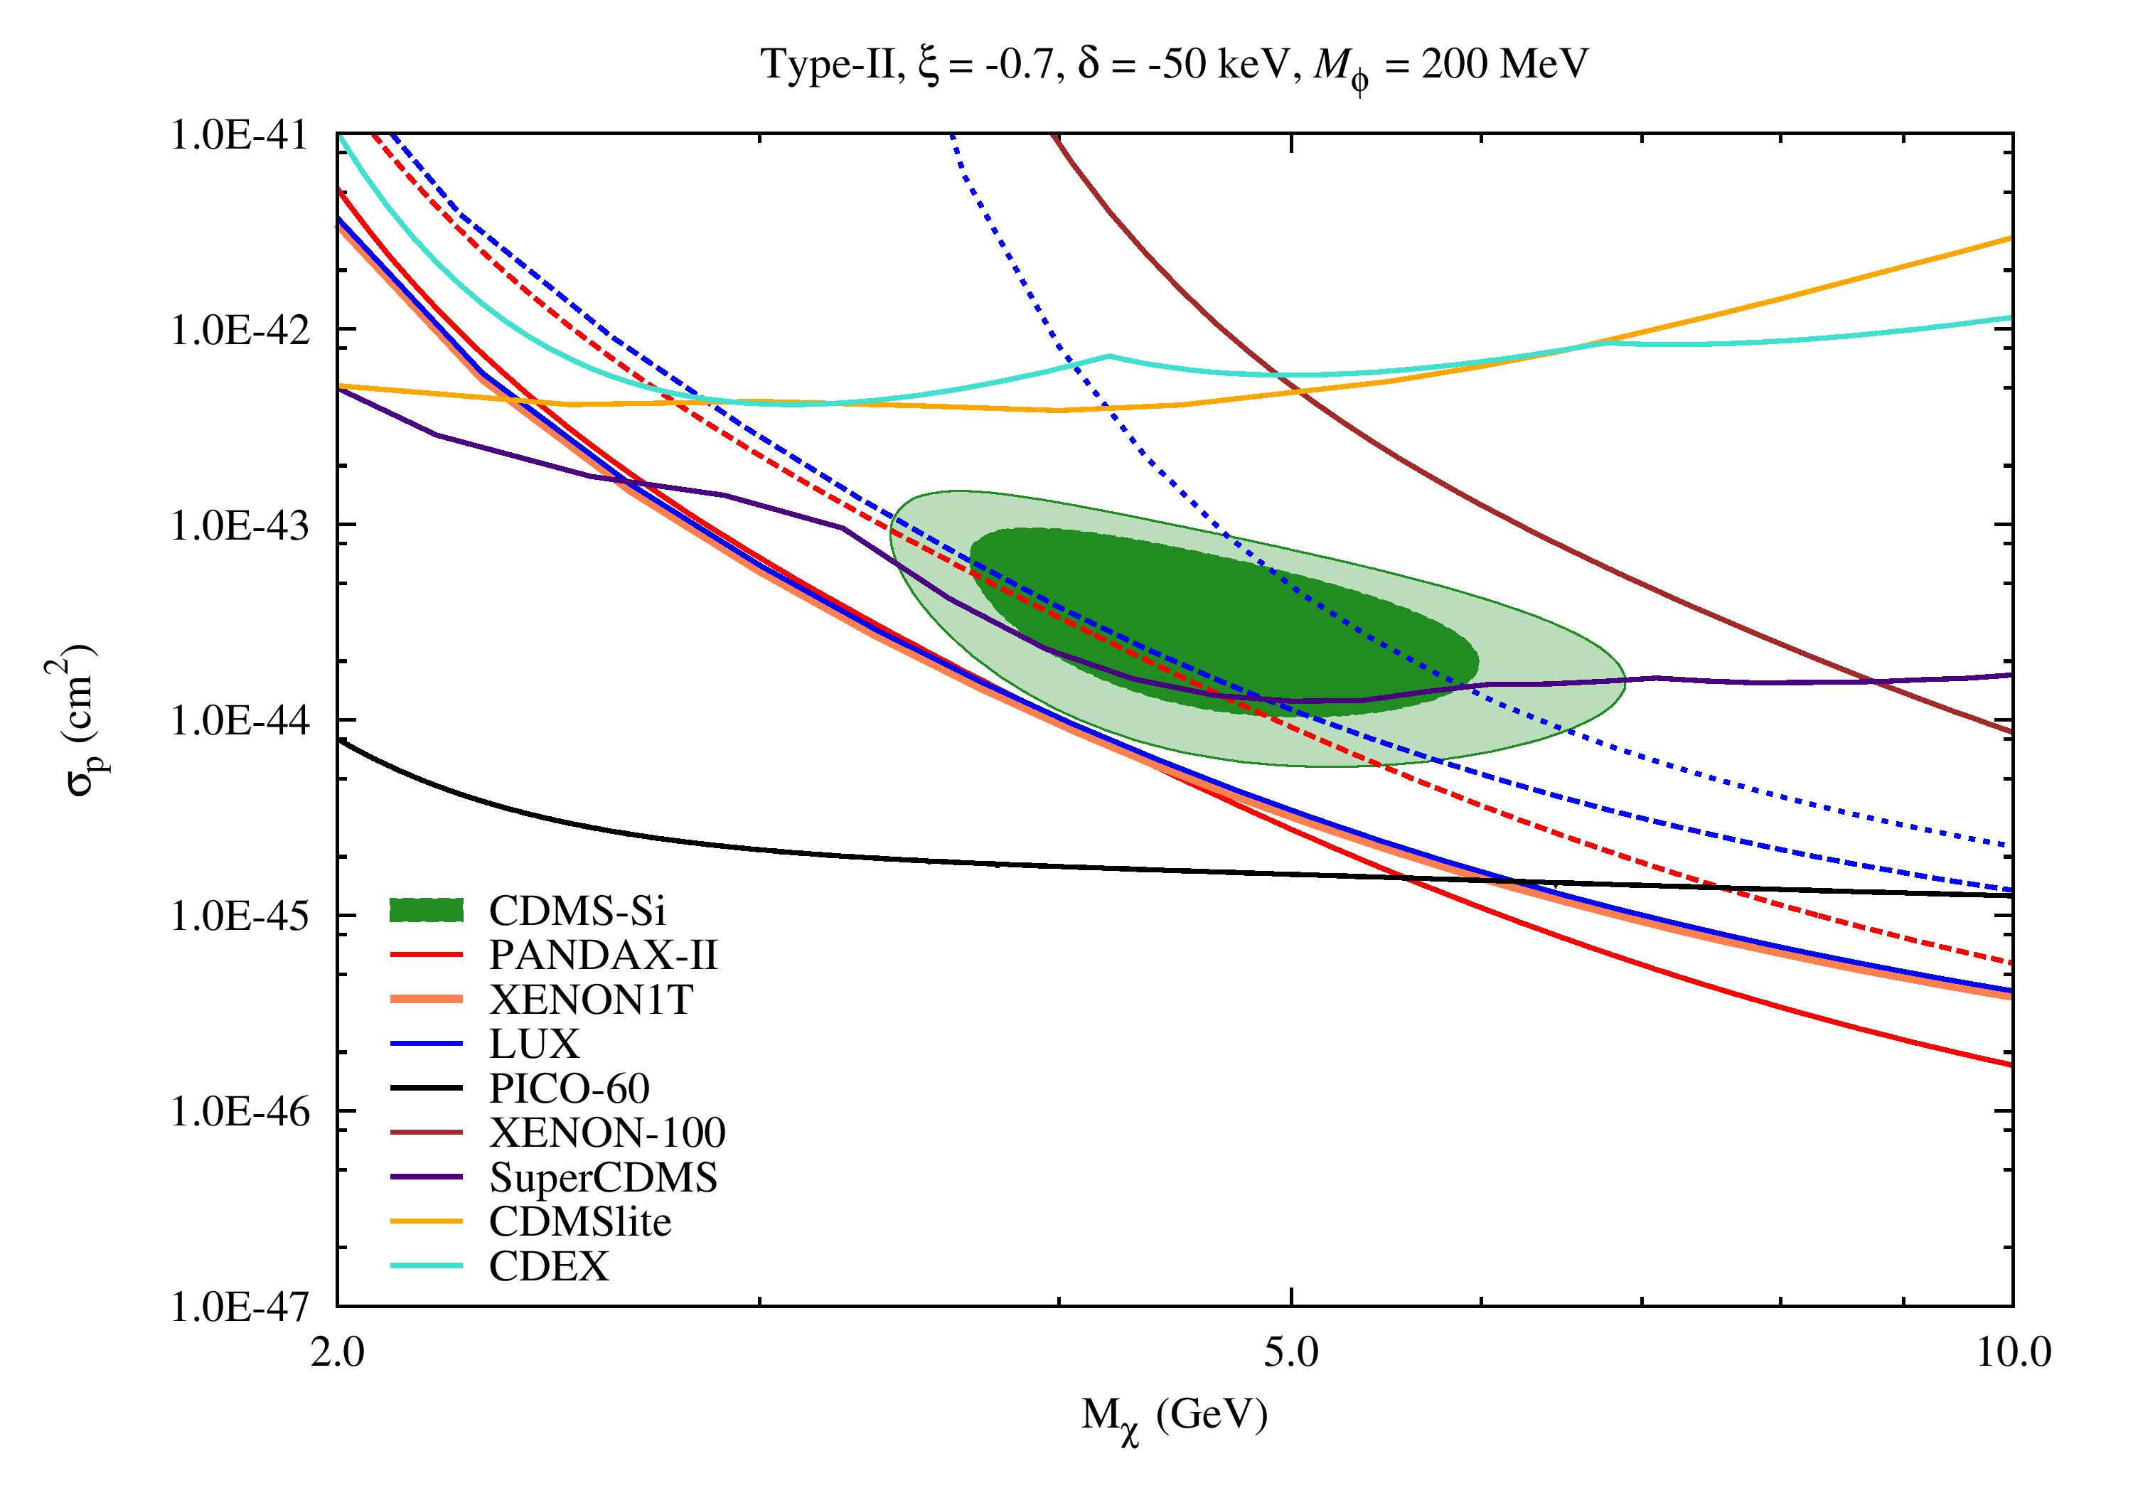
Fitting Results
5th International Workshop on Dark Matter, Dark Energy and Matter-Antimatter Asymmetry, 28/12/2018~1/1/2019
Exothermic Dark Matter with Isospin-Violating Couplings
(Xe-phobic Exothermic Dark Matter, mass splitting= -50 keV)

Slide 22
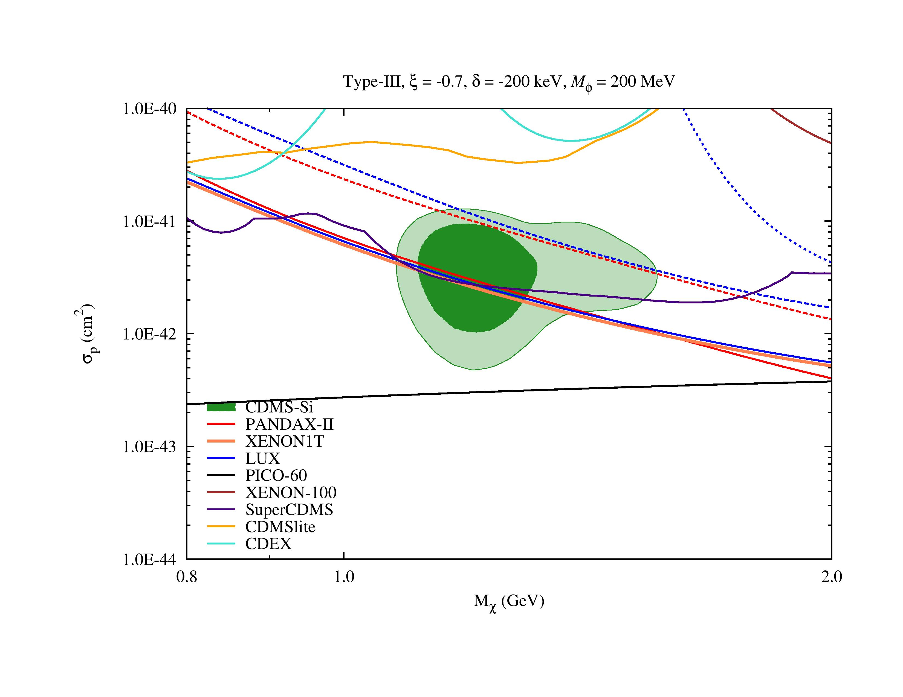
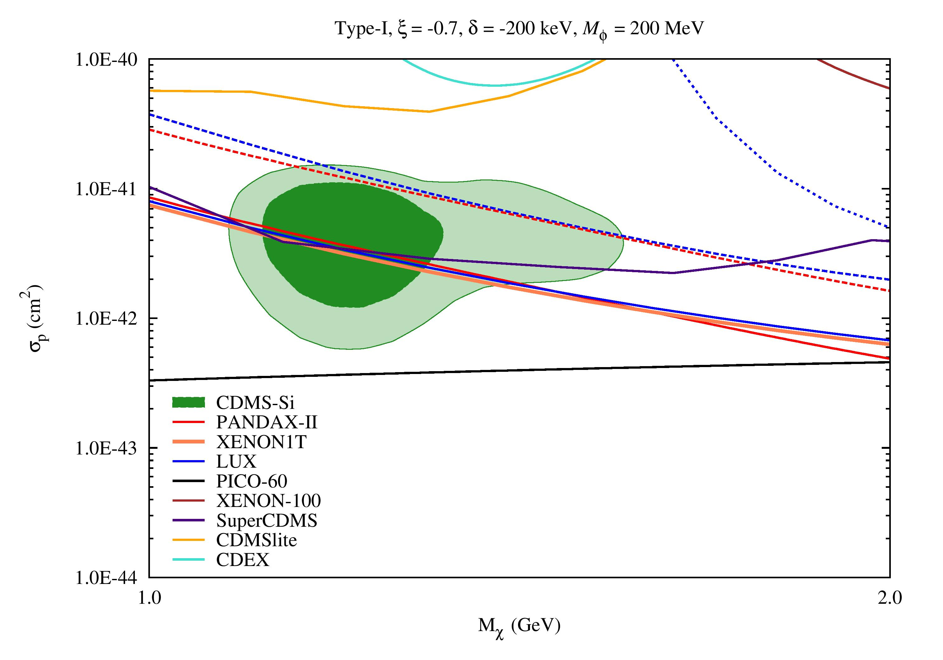
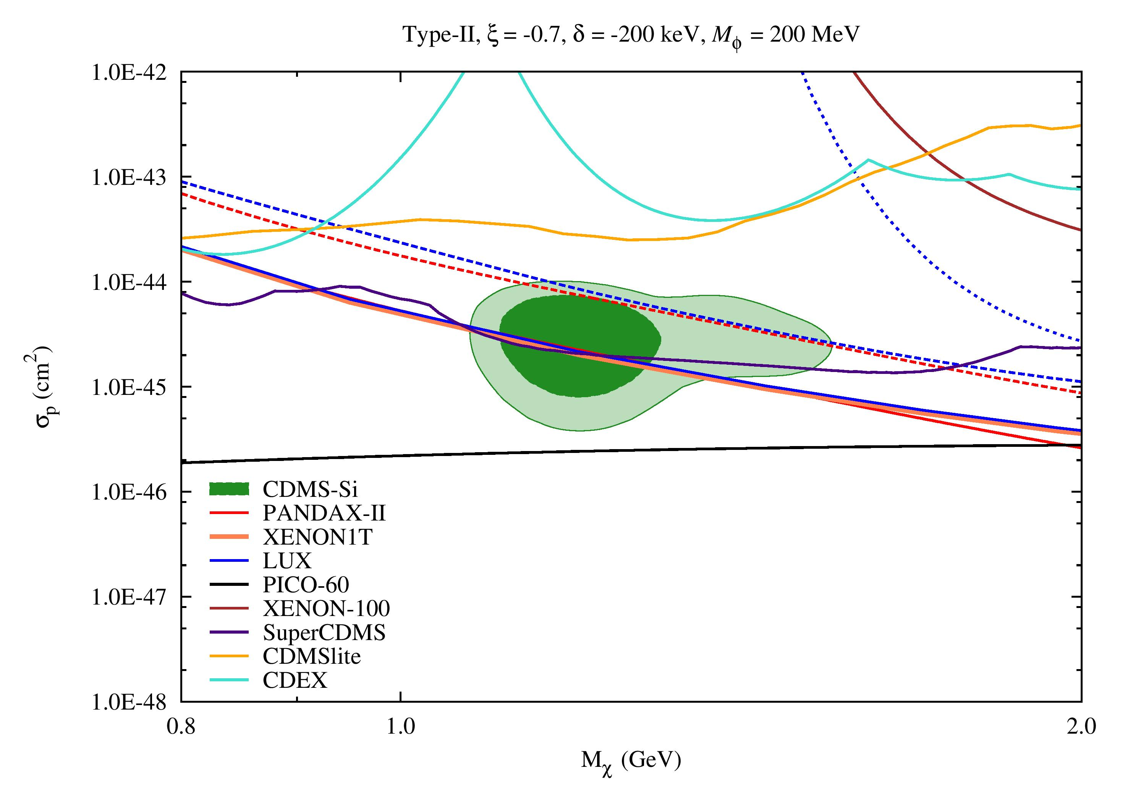
Fitting Results
5th International Workshop on Dark Matter, Dark Energy and Matter-Antimatter Asymmetry, 28/12/2018~1/1/2019
Exothermic Dark Matter with Isospin-Violating Couplings
(Xe-phobic Exothermic Dark Matter, mass splitting= - 200 keV)

Slide 23
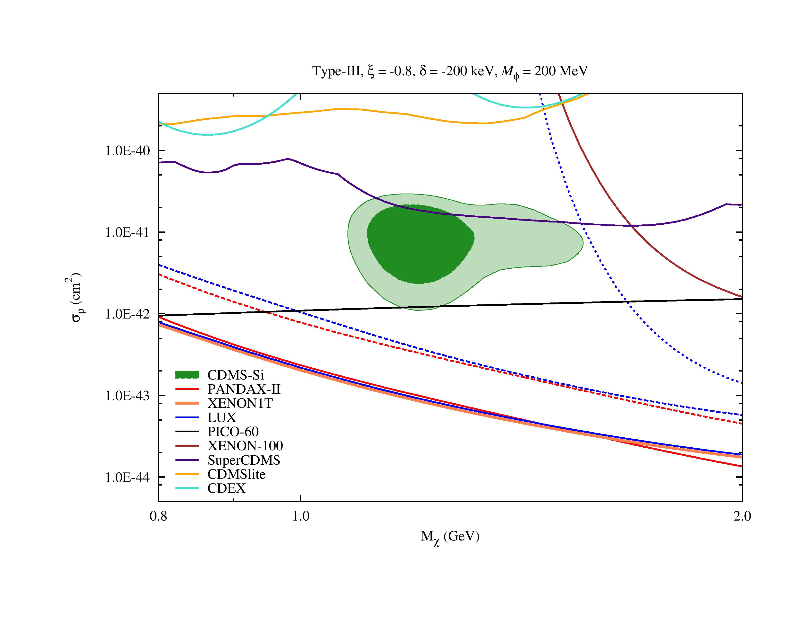
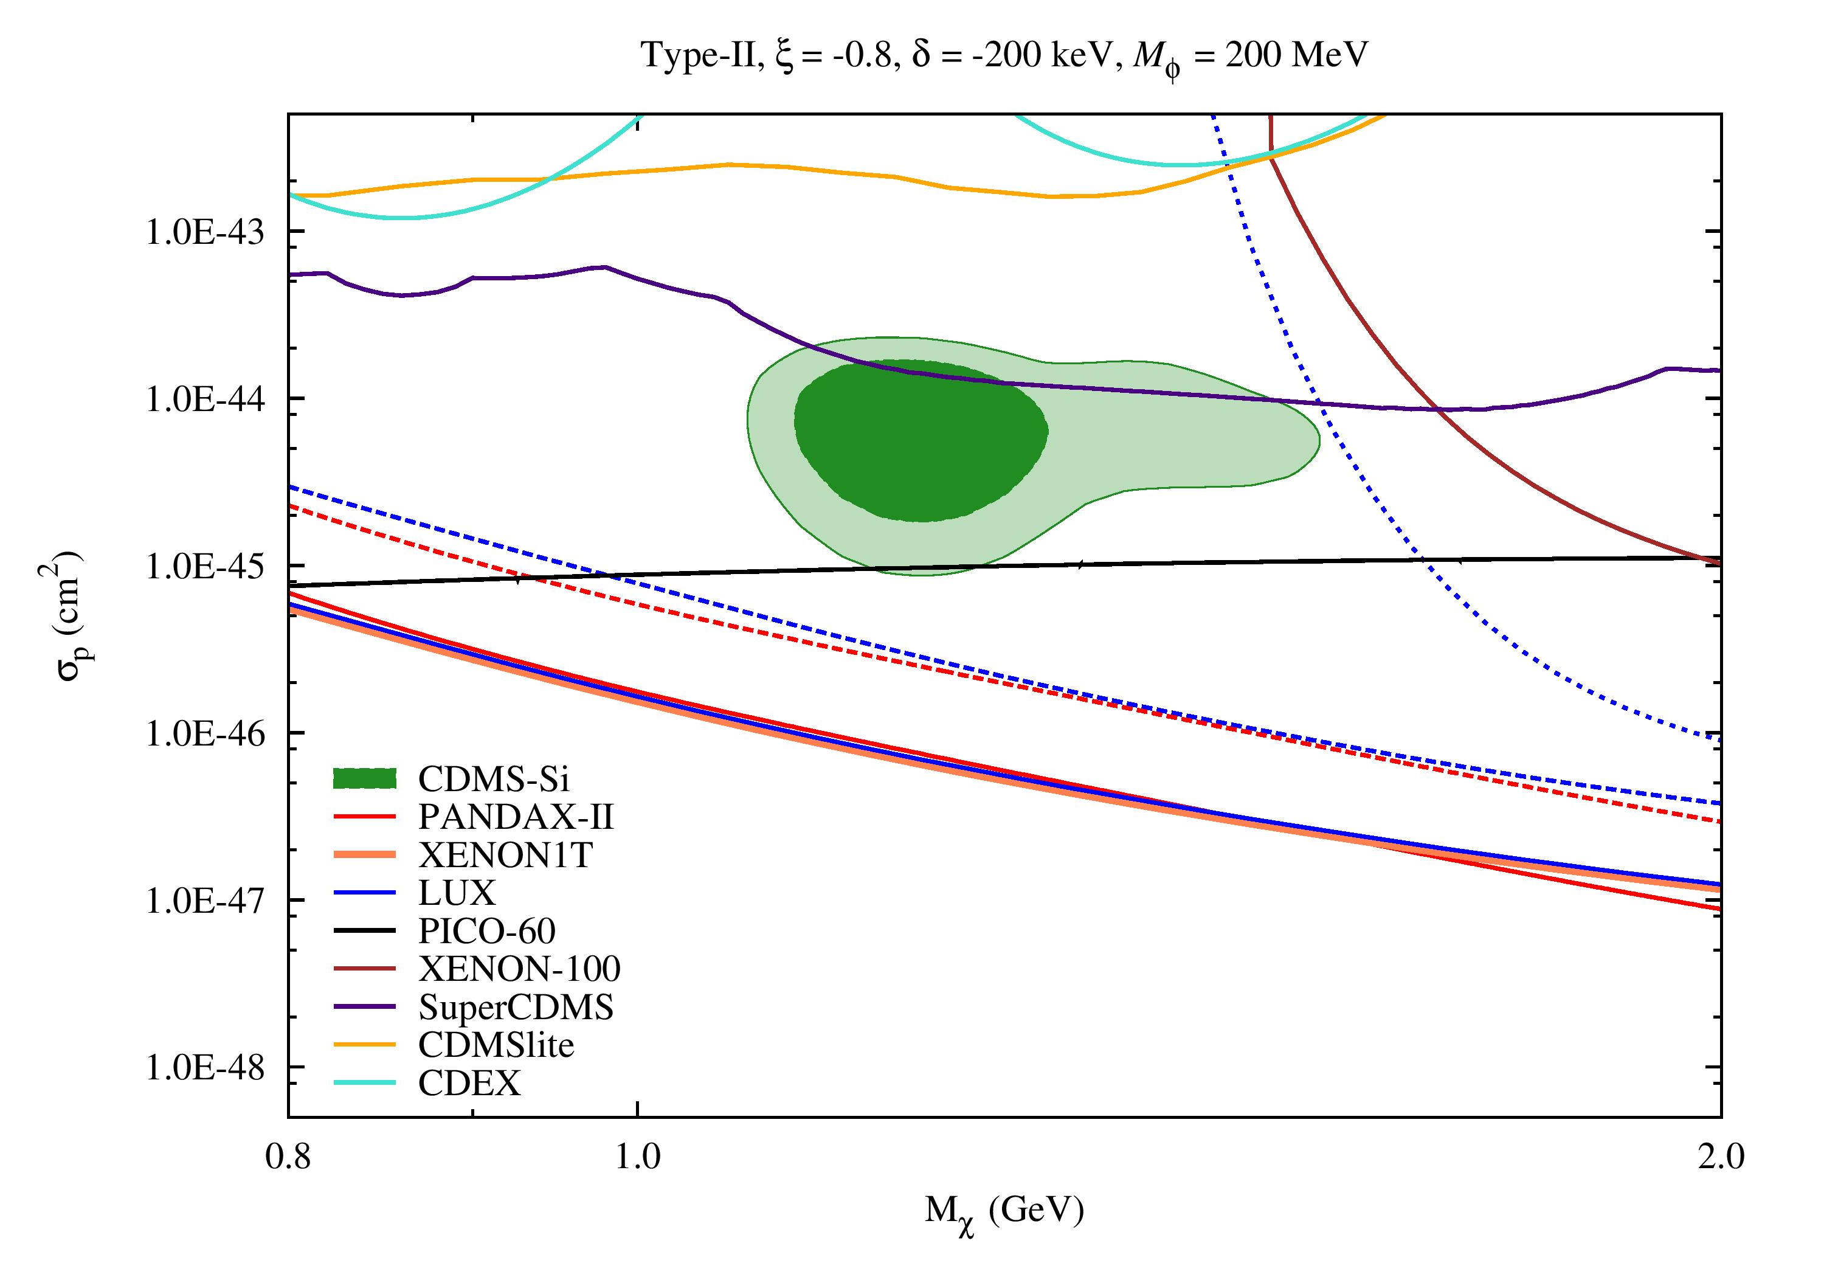
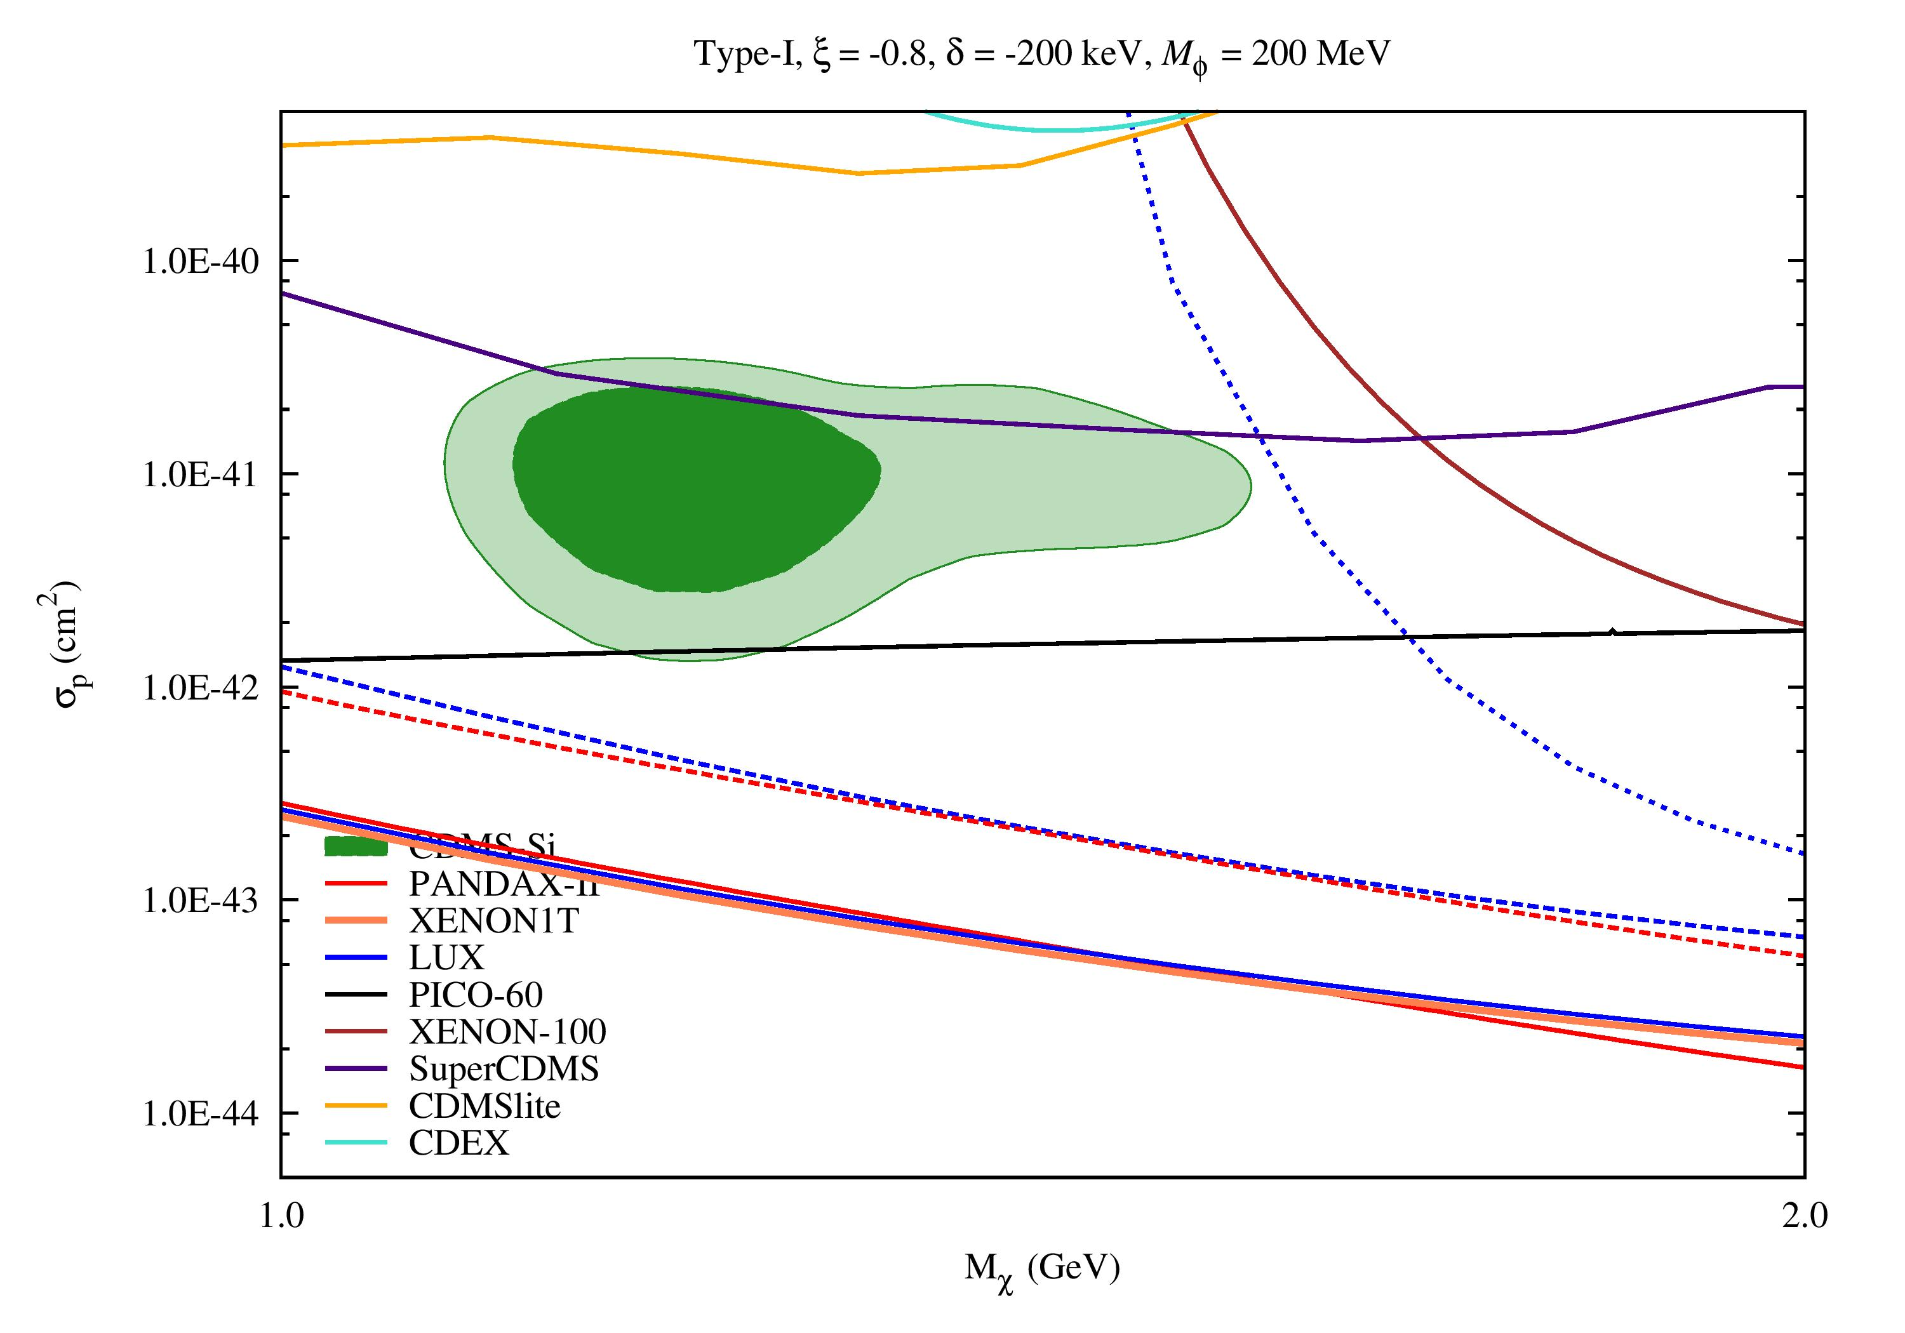
Fitting Results
5th International Workshop on Dark Matter, Dark Energy and Matter-Antimatter Asymmetry, 28/12/2018~1/1/2019
Exothermic Dark Matter with Isospin-Violating Couplings
(Ge-phobic Exothermic Dark Matter)

Slide 24
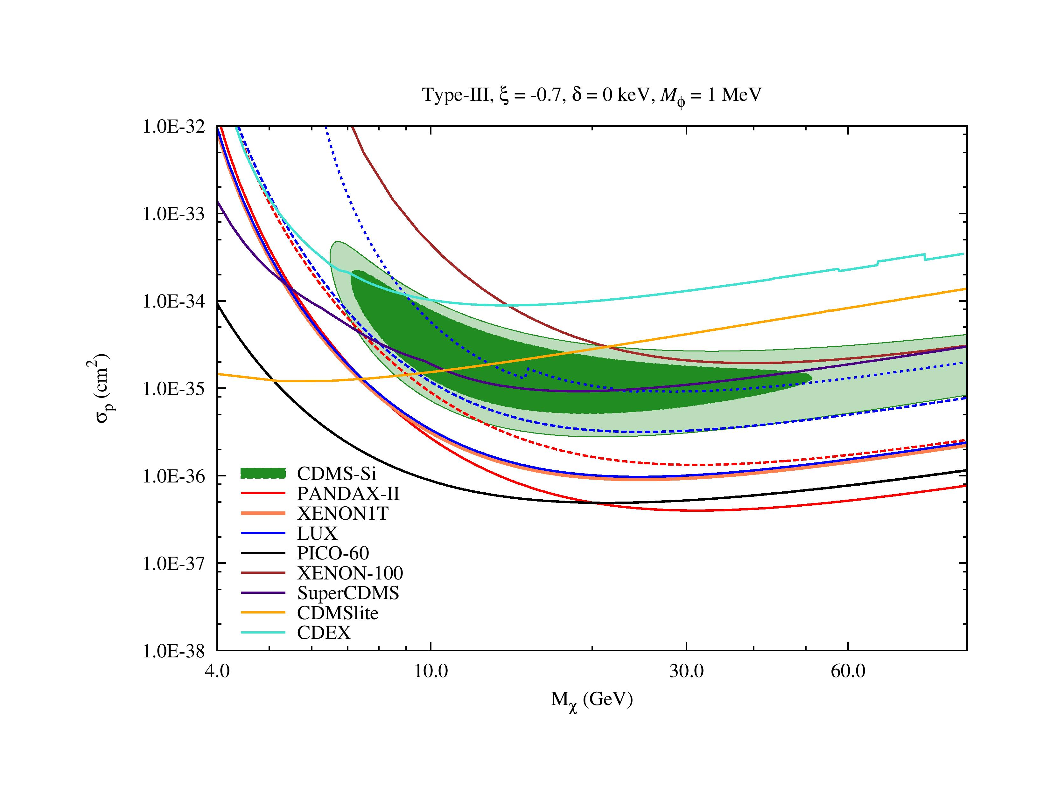
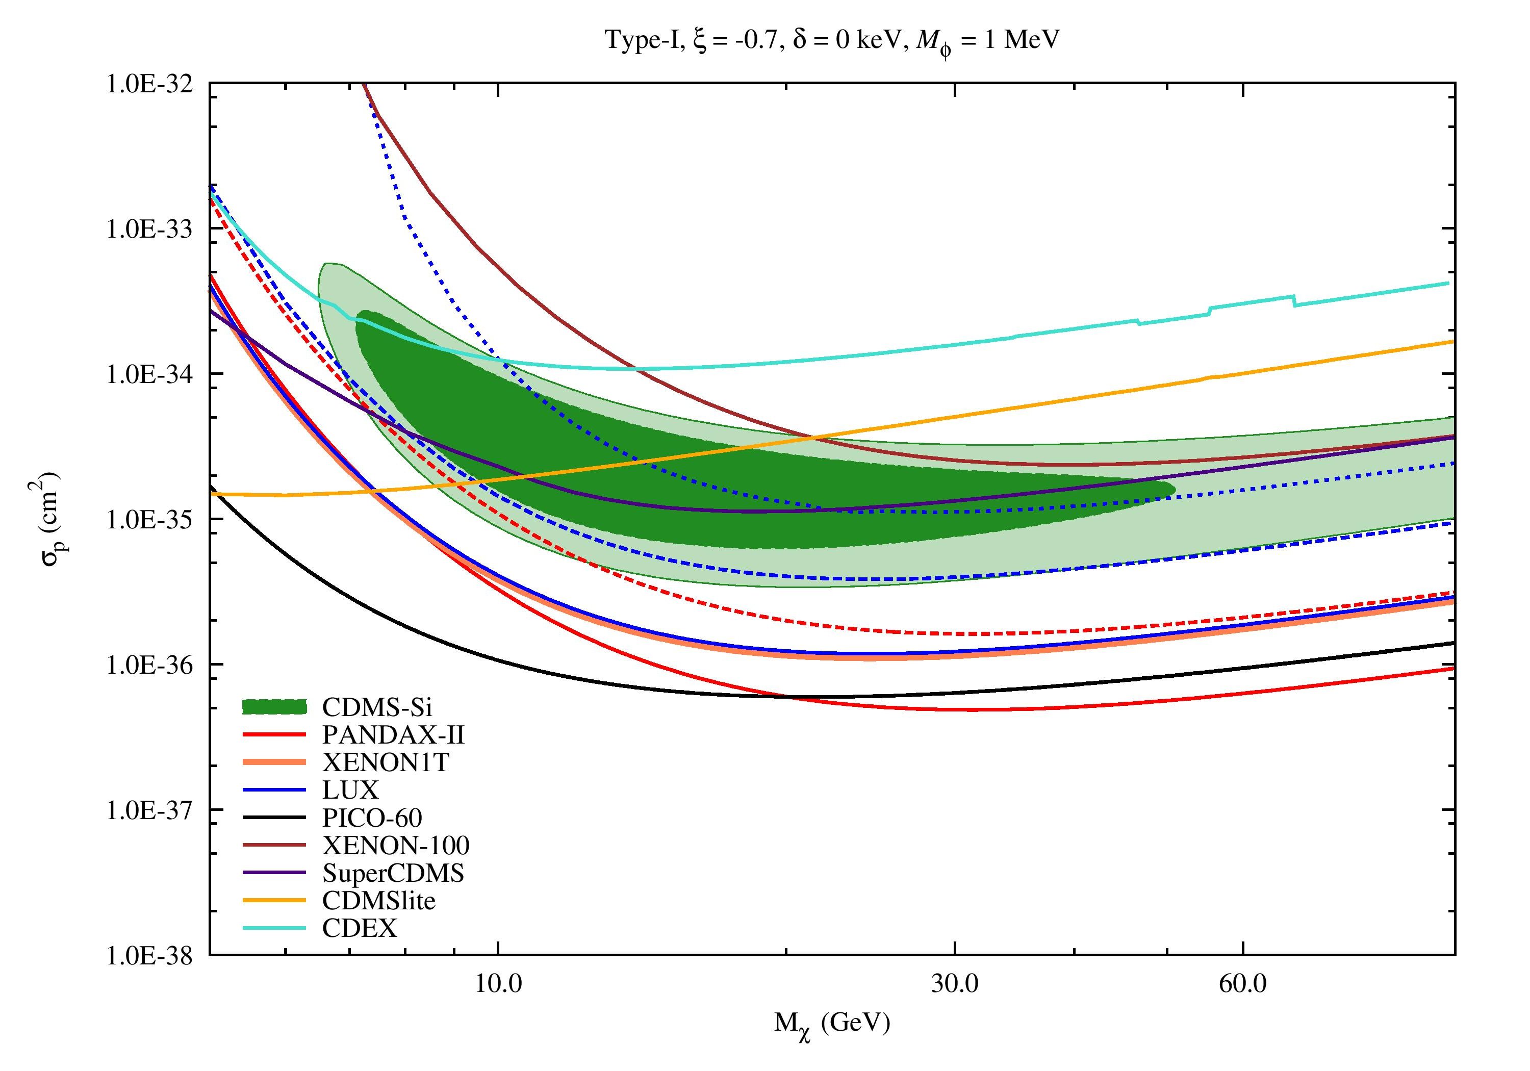
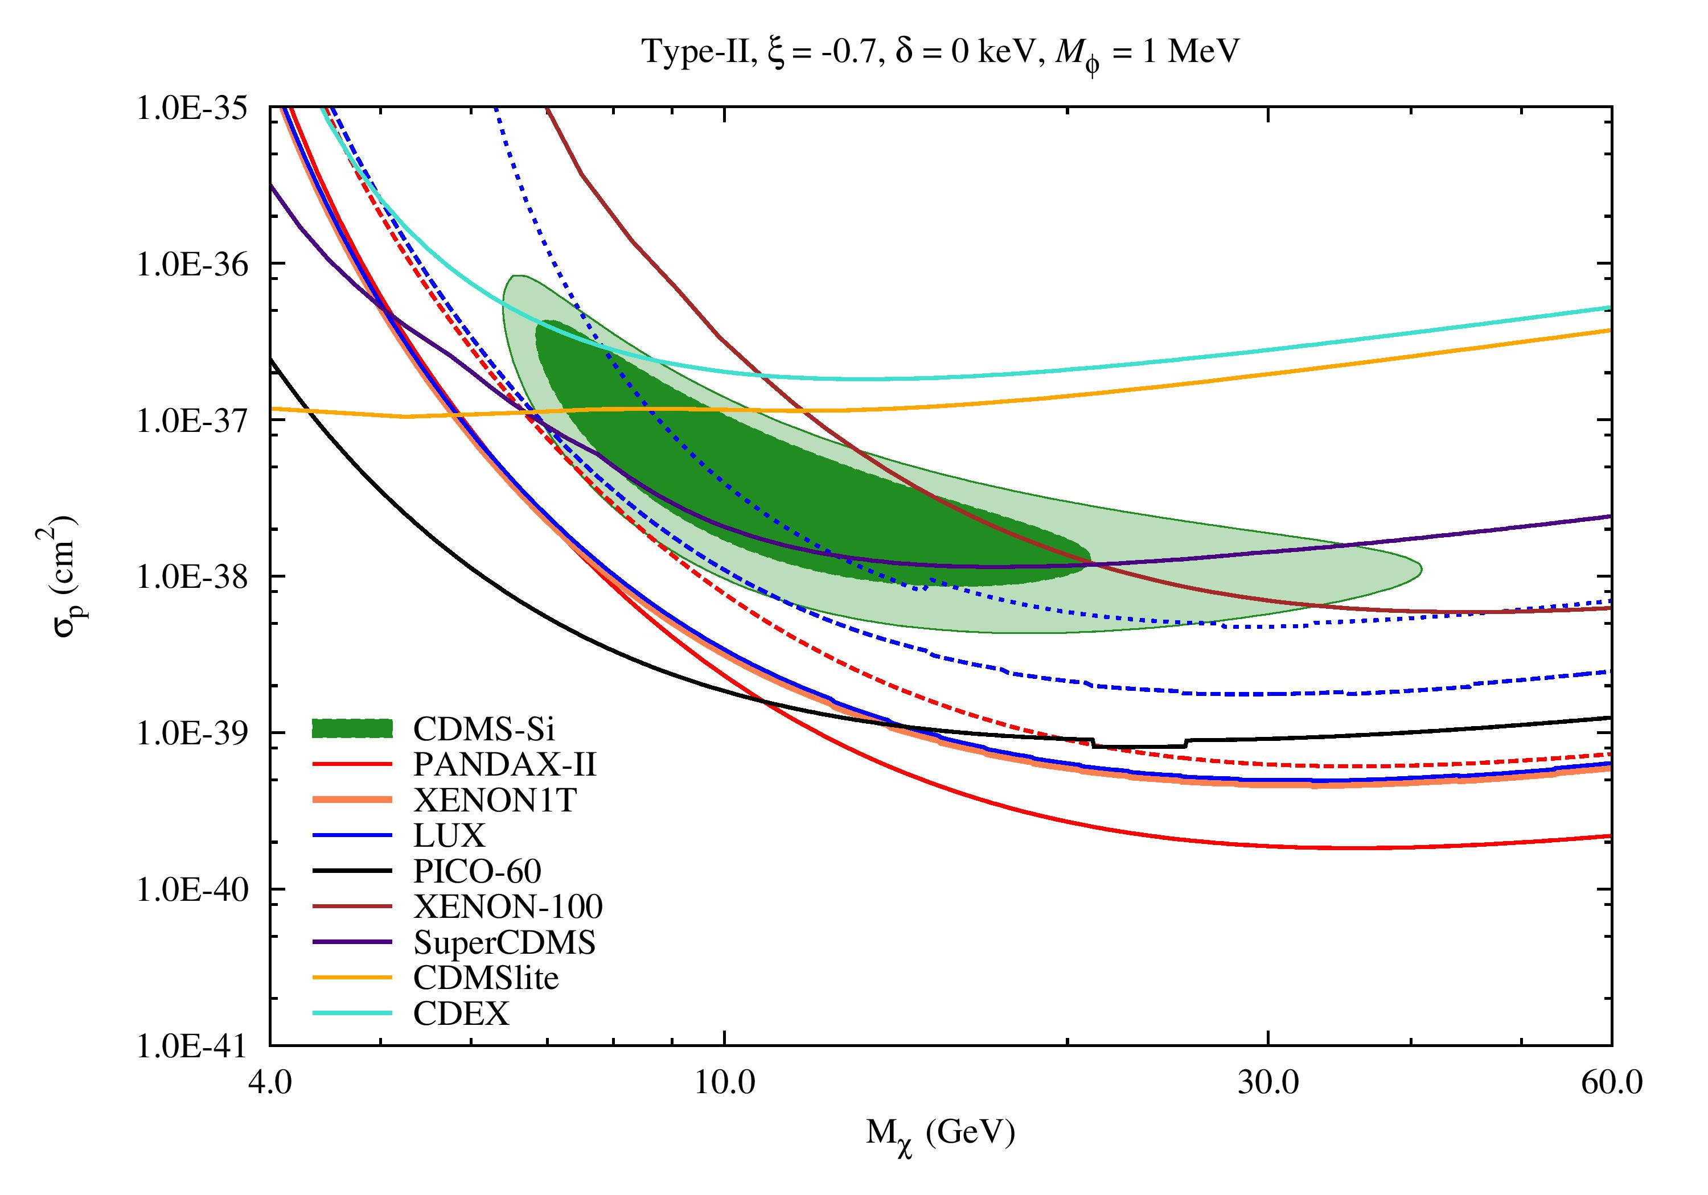
Fitting Results
5th International Workshop on Dark Matter, Dark Energy and Matter-Antimatter Asymmetry, 28/12/2018~1/1/2019
Xe-phobic Dark Matter with a Light Mediator

Slide 25
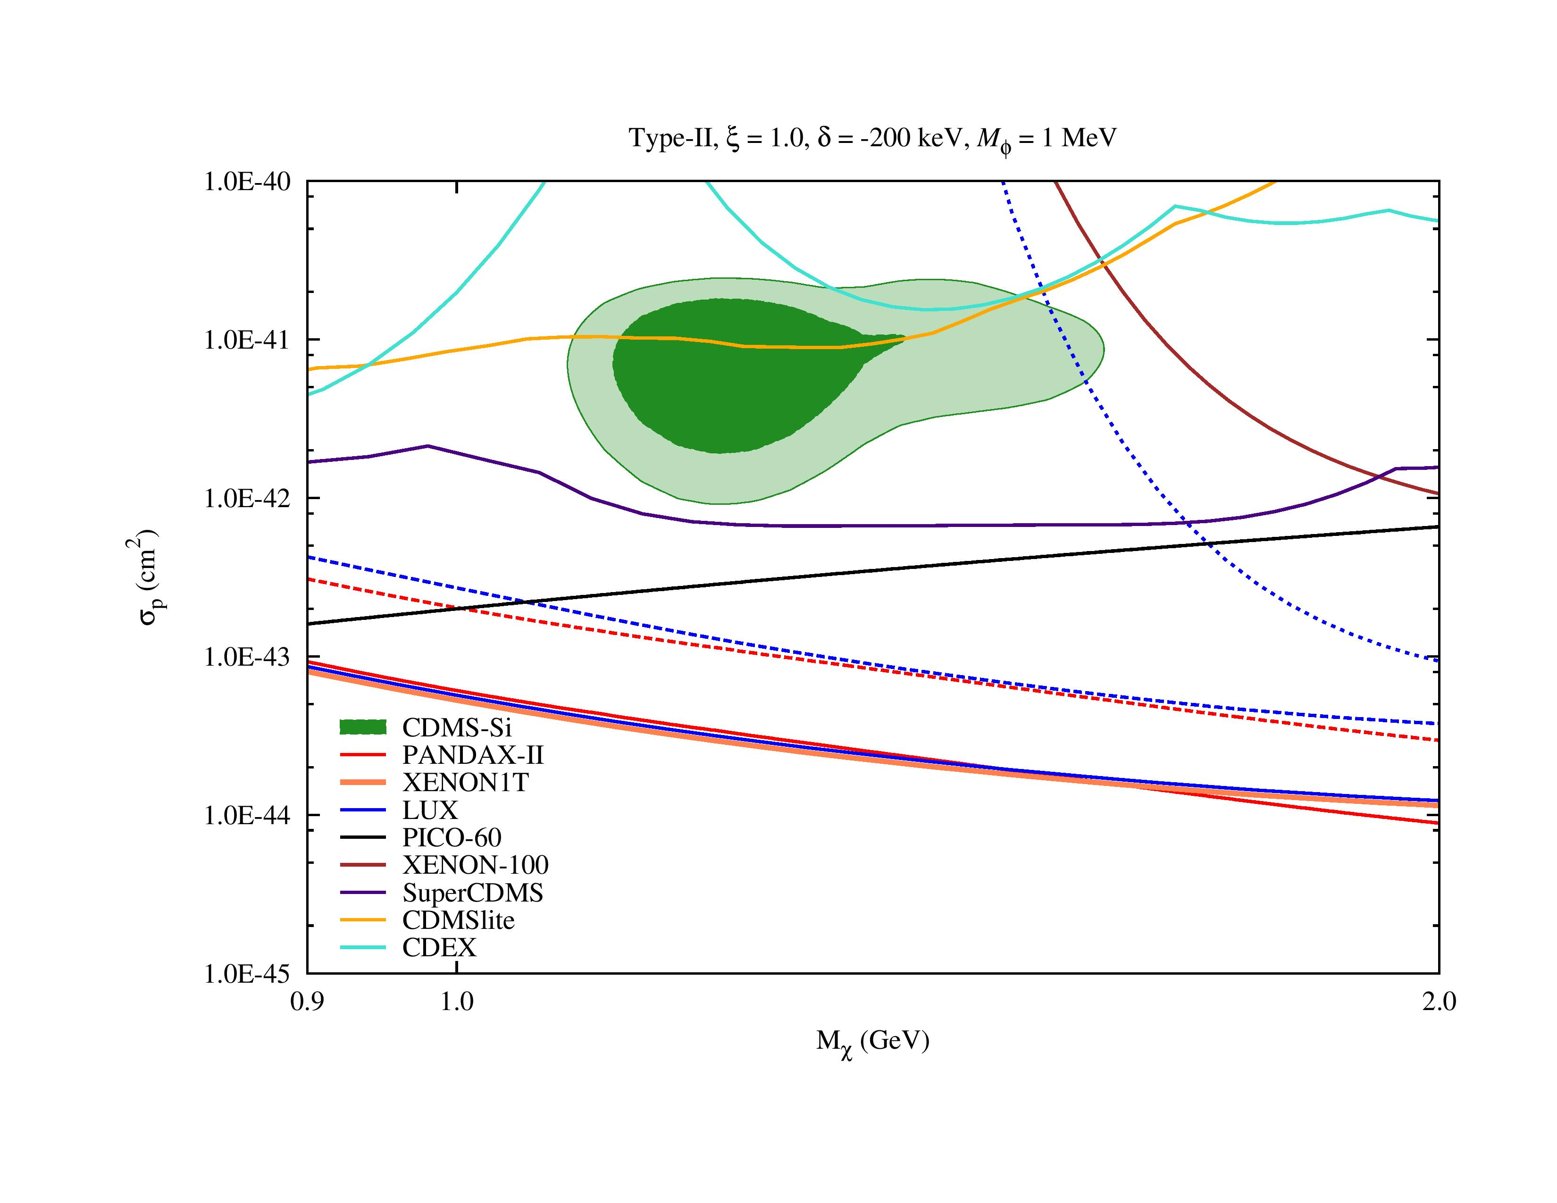
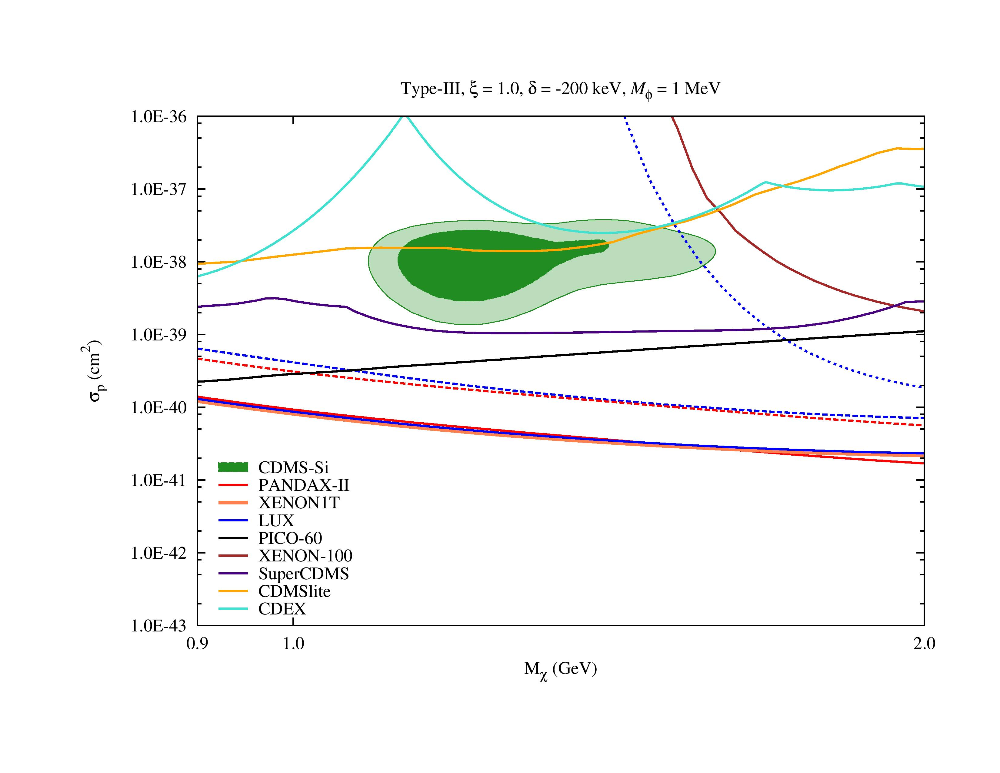
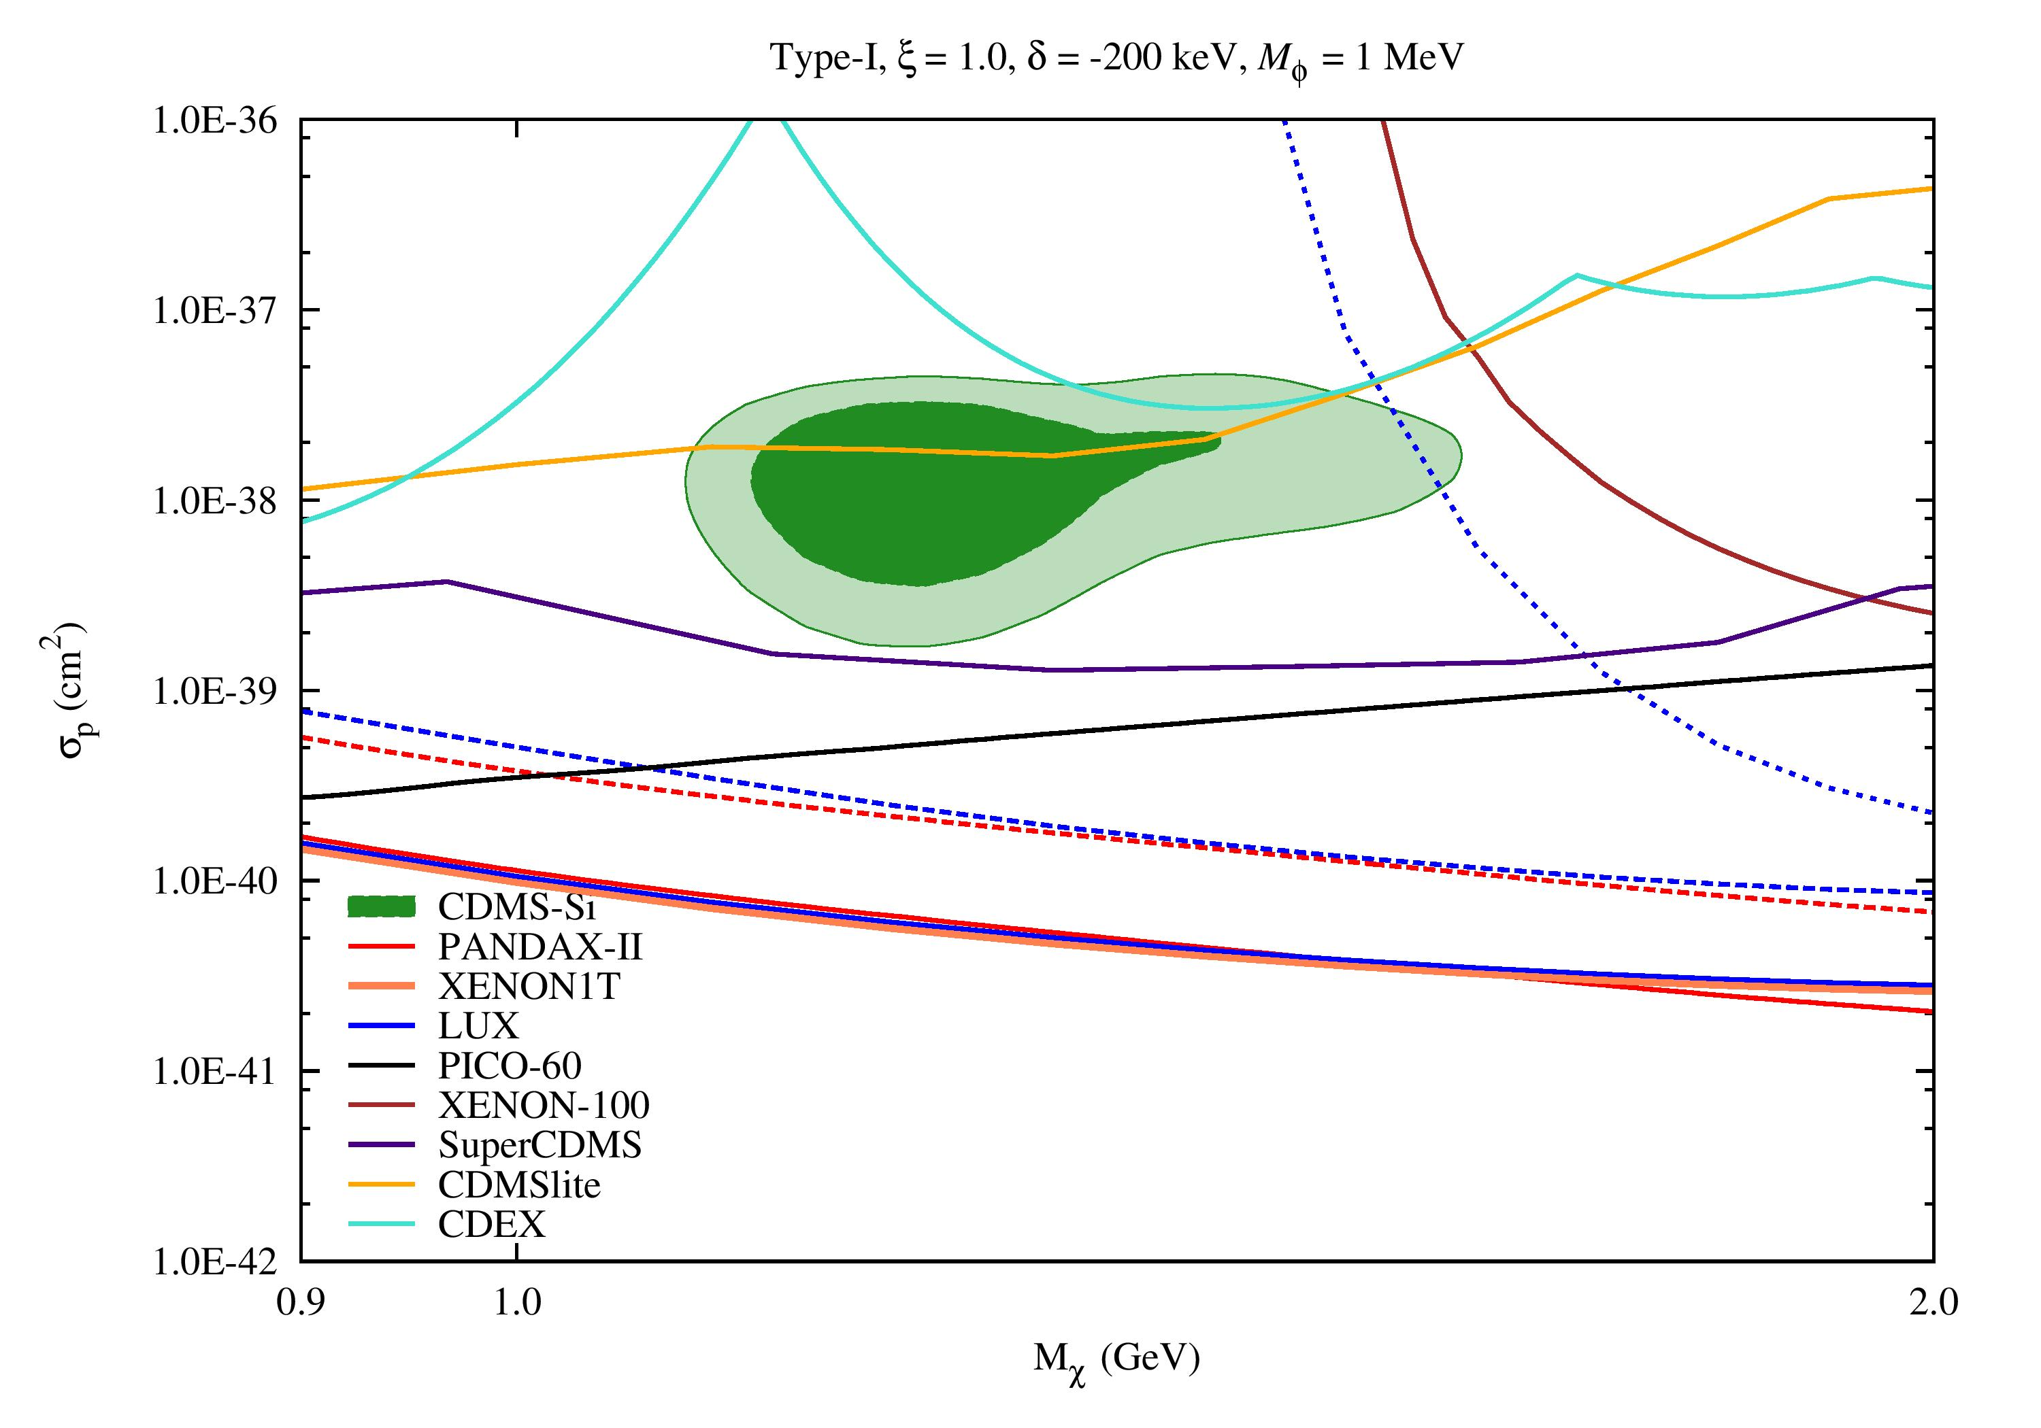
Fitting Results
5th International Workshop on Dark Matter, Dark Energy and Matter-Antimatter Asymmetry, 28/12/2018~1/1/2019
Exothermic Dark Matter with a Light Mediator

Slide 26
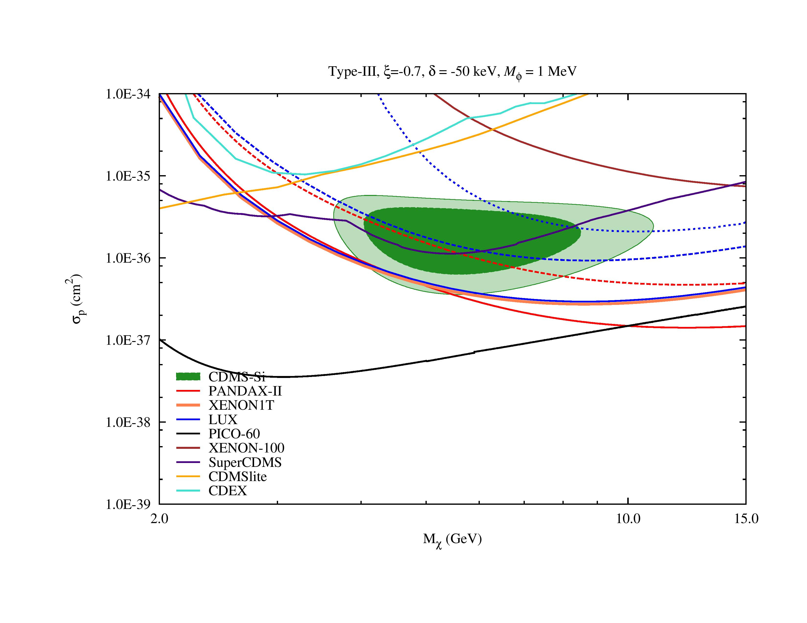
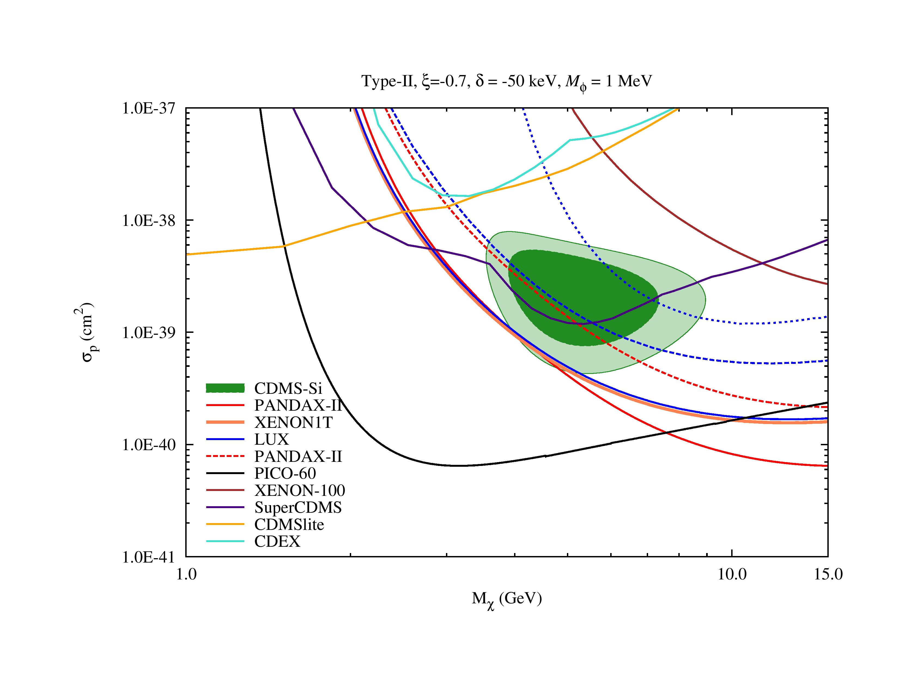
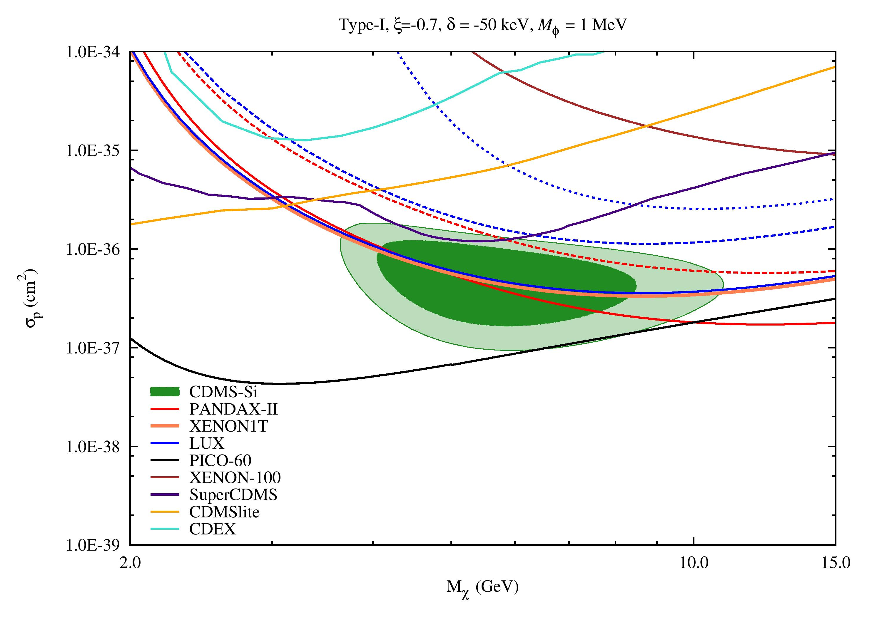
Fitting Results
5th International Workshop on Dark Matter, Dark Energy and Matter-Antimatter Asymmetry, 28/12/2018~1/1/2019
Exothermic Dark Matter with a Light Mediator and Isospin Violation
(mass splitting: -50 keV)

Slide 27
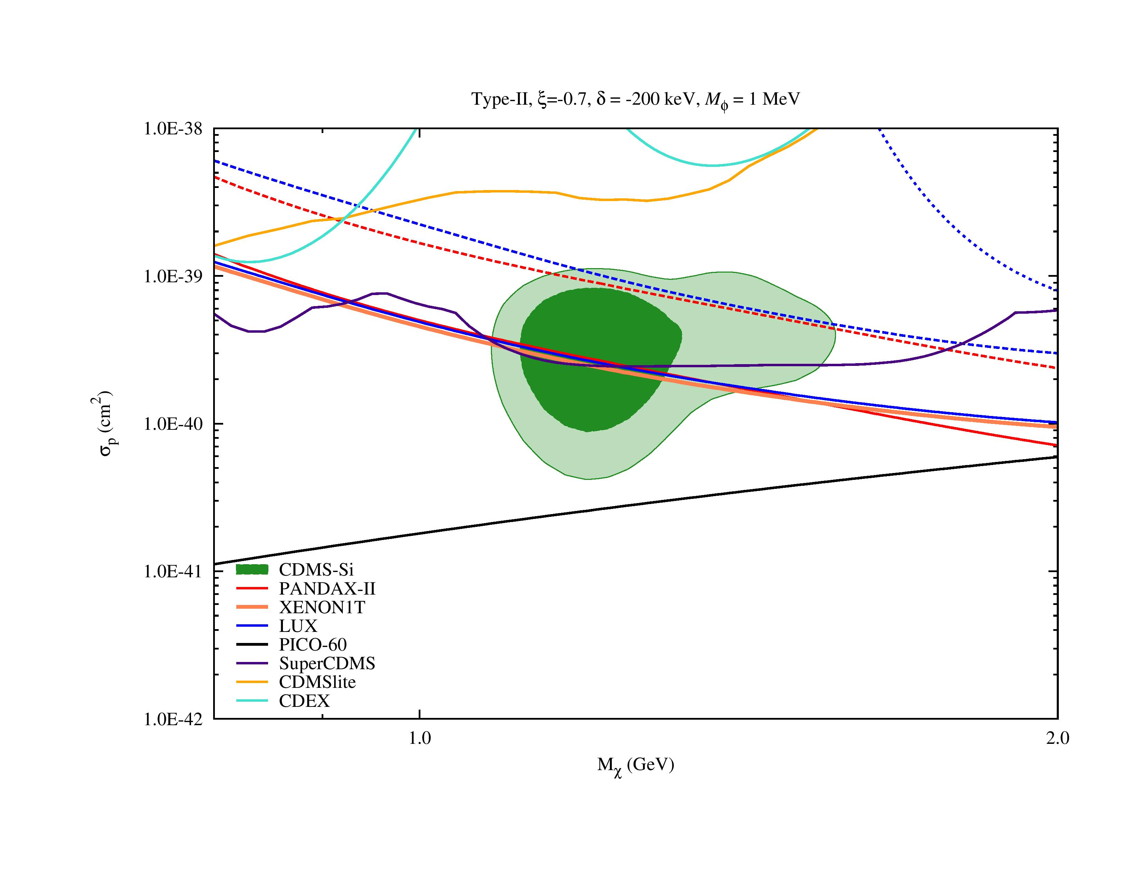
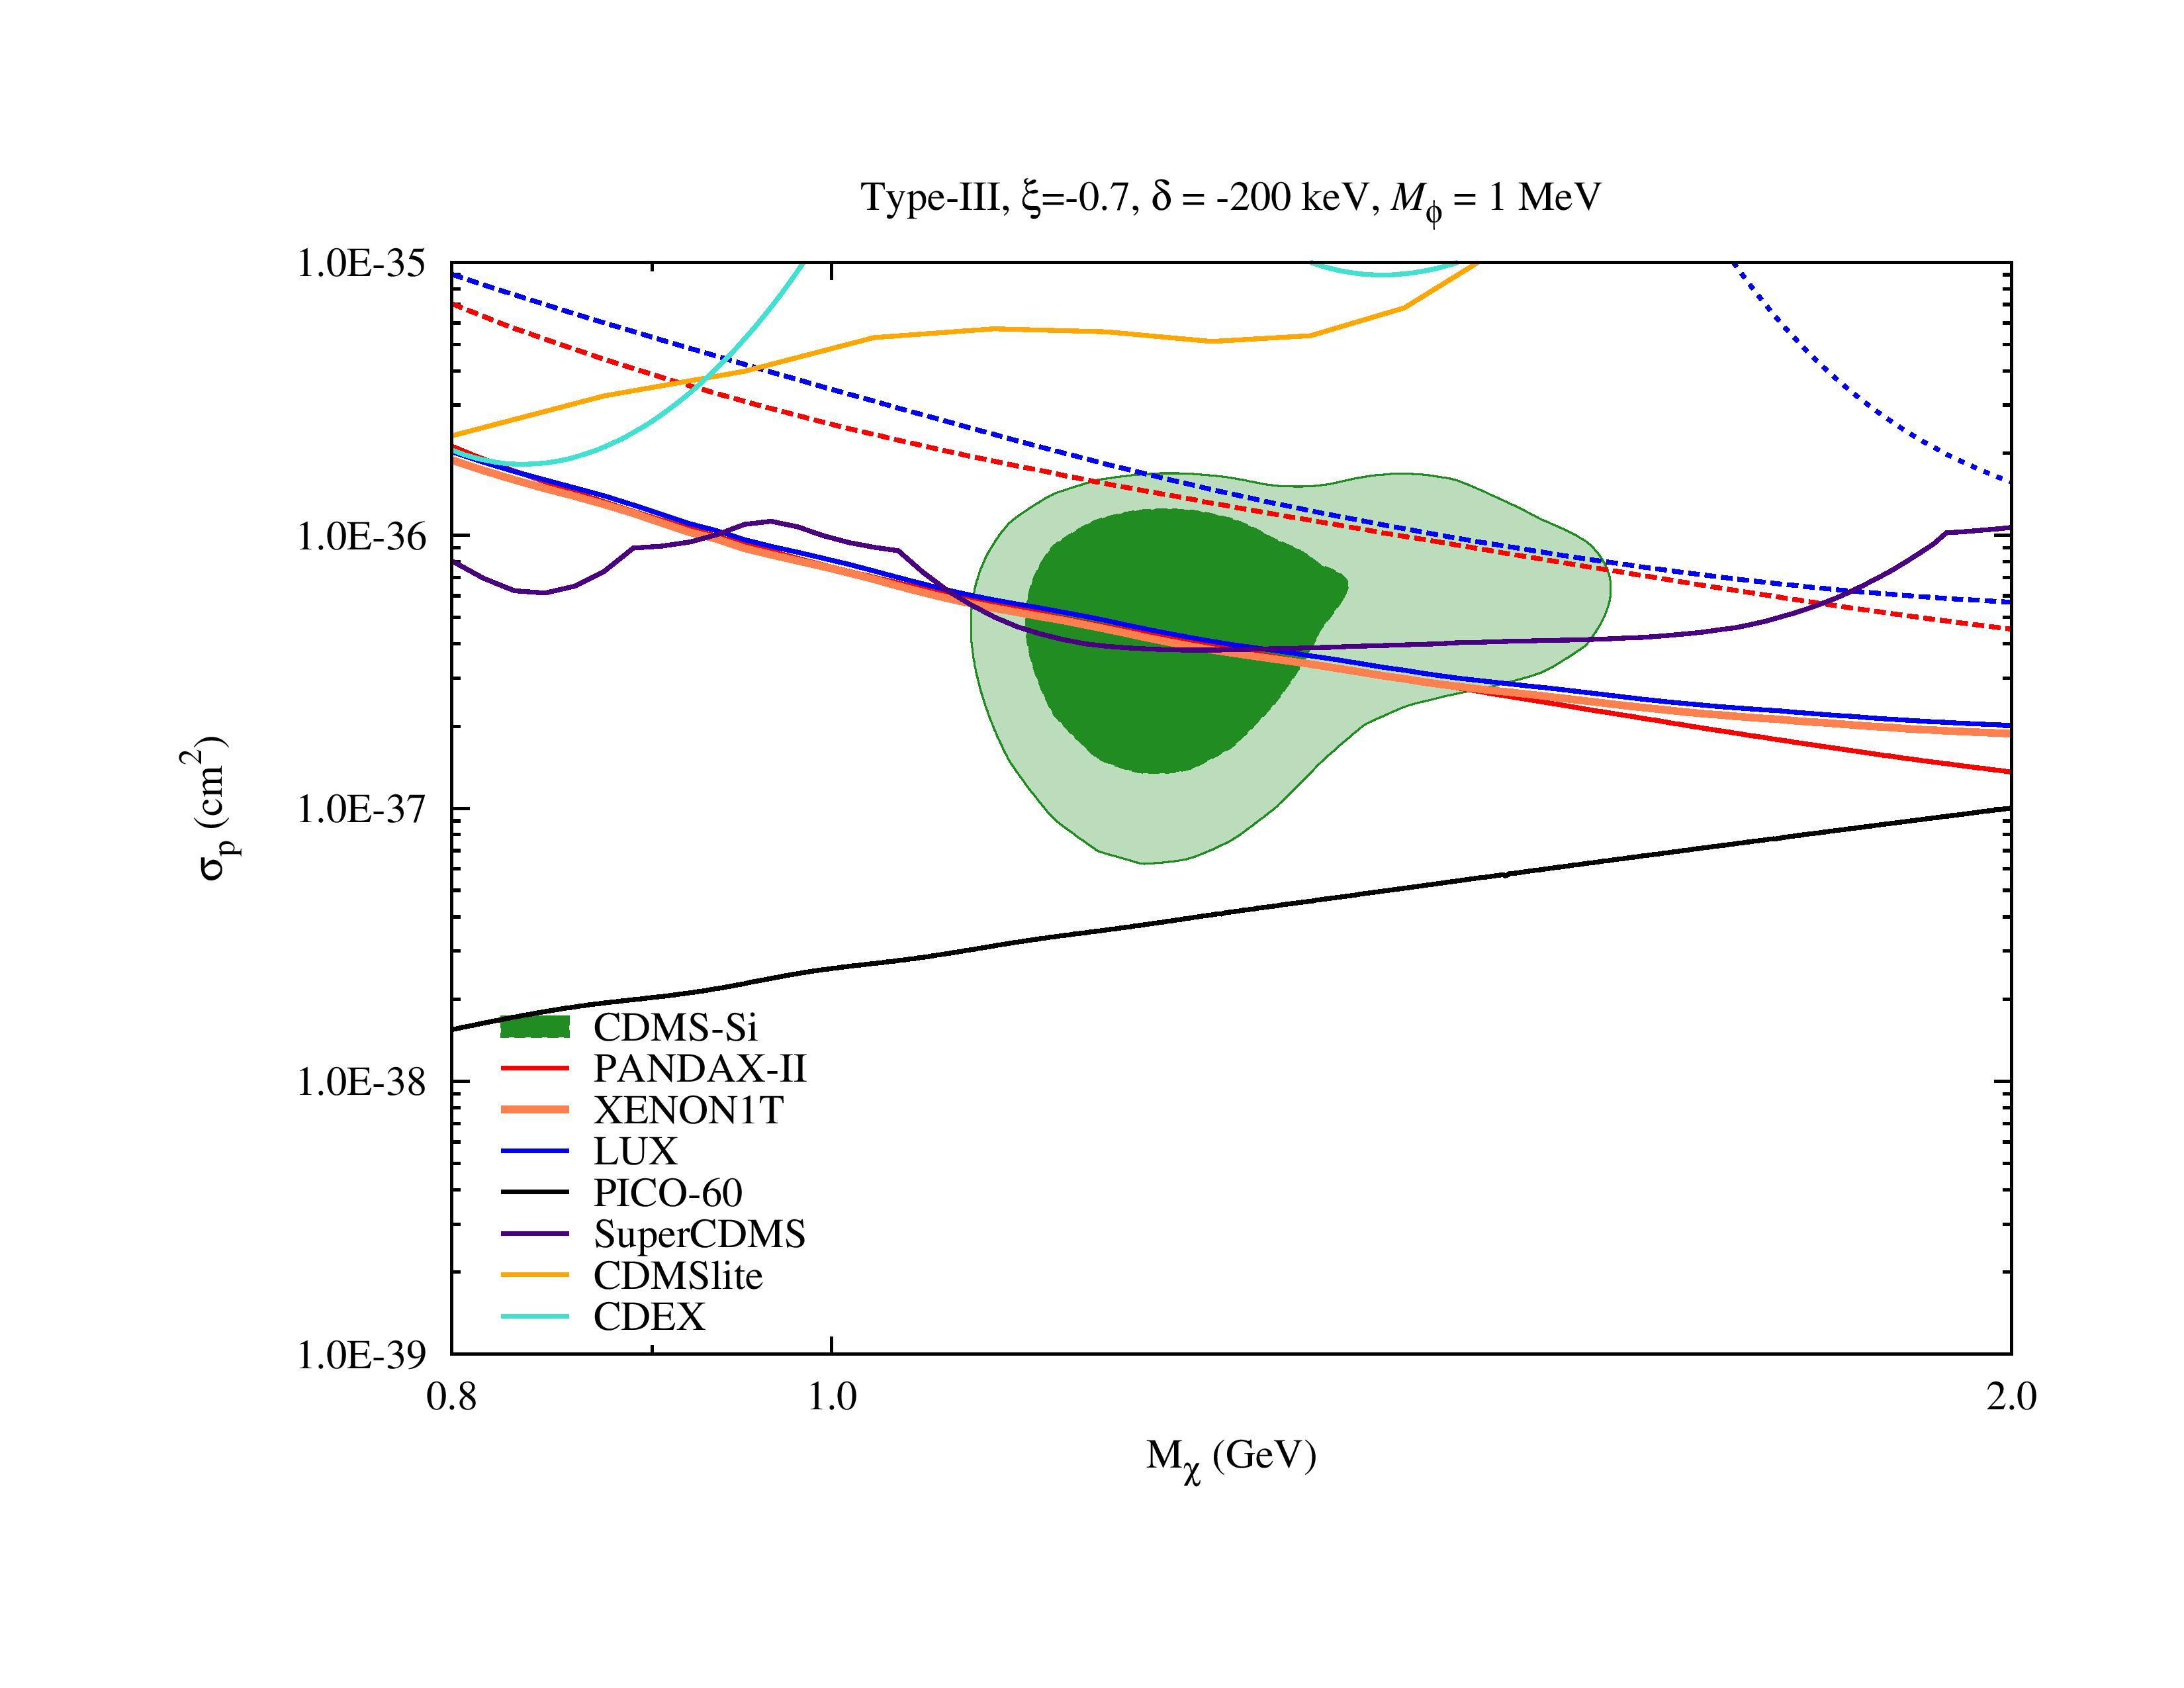
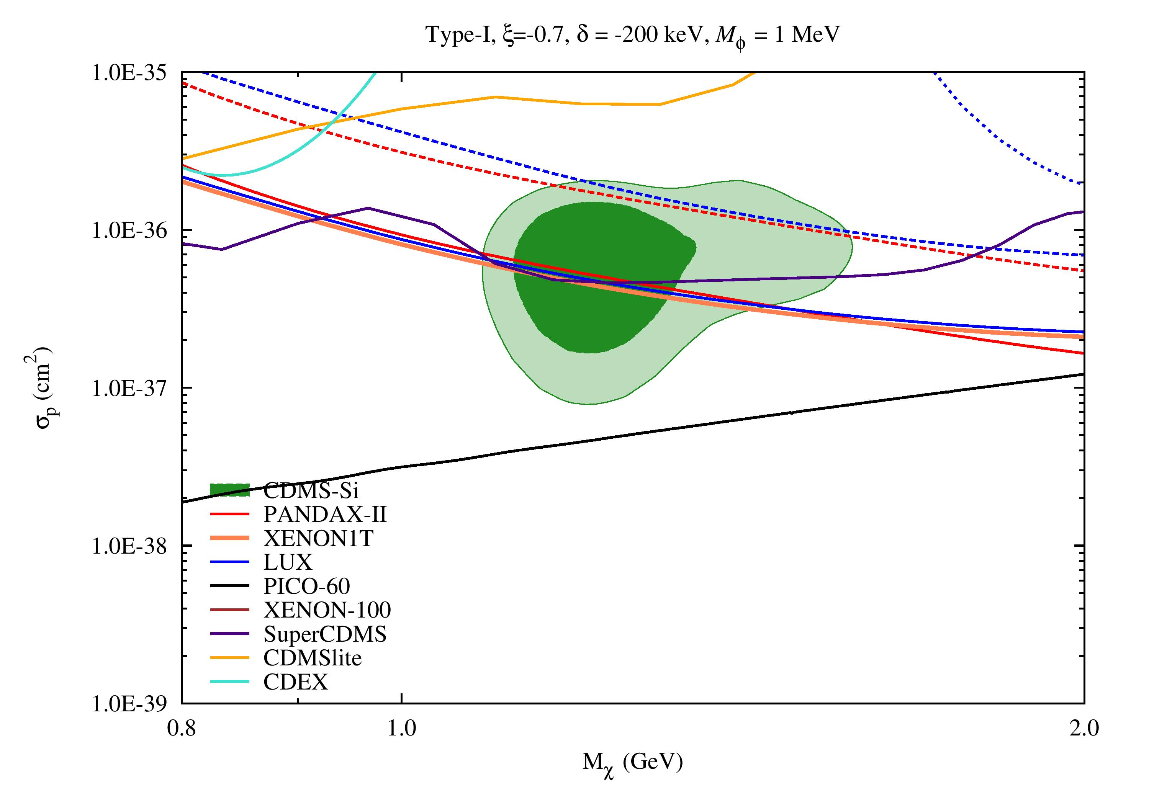
Fitting Results
5th International Workshop on Dark Matter, Dark Energy and Matter-Antimatter Asymmetry, 28/12/2018~1/1/2019
Exothermic Dark Matter with a Light Mediator and Isospin Violation
(mass splitting: -200 keV)

Slide 28
Conclusions
5th International Workshop on Dark Matter, Dark Energy and Matter-Antimatter Asymmetry, 28/12/2018~1/1/2019
Considered the direct detections of WIMP particles with the spin-independent interactions
Examined the models which involve different combinations of the three mechanisms below:
  Isospin violation
  Exothermic scattering
  Light mediator
All combinations have been ruled out
This framework cannot be used to explain the CDMS-Si’s excess anymore!

Slide 29

5th International Workshop on Dark Matter, Dark Energy and Matter-Antimatter Asymmetry, 28/12/2018~1/1/2019

Slide 30

Backup
5th International Workshop on Dark Matter, Dark Energy and Matter-Antimatter Asymmetry, 28/12/2018~1/1/2019
At nucleus level, the G-factor for each type of the operators:
  Type-I: ${G_{1}^{T}\left(q^{2},υ\right)=G}_{1}\left(q^{2},υ\right)$
  $$\text{Type}\text{−}\text{II}\text{: }{G_{2}^{T}\left(q^{2},υ\right)=G}_{2}\left(q^{2},υ\right)$$
  Type-III: $G_{3}^{T}\left(q^{2},υ\right)=\frac{(υ^{2}−q^{2}/4μ_{χT}^{2})/υ_{ref}^{2}}{{I_{3}(\frac{q_{min}^{2}}{m_{ϕ}^{2}},\frac{q_{ref}^{2}}{m_{ϕ}^{2}})\left(1+q^{2}/m_{ϕ}^{2}\right)}^{2}}$
Response function related to the experimental resolution:
  (the measured signals are normally distributed about $f_{s}\left(E_{nr}\right)$ with a standard deviation σ(s))
  $$Φ\left(f_{s}\left(E_{nr}\right),s_{1},s_{2}\right)=\frac{1}{2} \left[\operatorname{erf}\left(\frac{s_{2}−f_{s}\left(E_{nr}\right)}{\text{σ}\sqrt{2}}\right)−erf⁡(\frac{s_{1}−f_{s}\left(E_{nr}\right)}{\text{σ}\sqrt{2}})\right]$$

Slide 31

Backup
5th International Workshop on Dark Matter, Dark Energy and Matter-Antimatter Asymmetry, 28/12/2018~1/1/2019
Experiment | Fitting Method
CDMS-Si | Three candidate events have been observed. We bin the data in 2 keV intervals. To obtain the best-fit regions, we maximize the log of the extended likelihood function.
SuperCDMS | We obtain the 90% confidence level (C. L.) exclusion limits on the spin-independent WIMP-nucleon cross section based on the $p_{max}$ method with a perfect energy resolution and no background subtraction.
CDMSlite | We exploit the $p_{max}$ method with no background subtraction to obtain the 90% C. L. exclusion limits
CDEX | The 90% exclusion limits are obtained by performing the binned Poisson method with bins of 0.1 ${keV}_{ee}$
LUX (2013 & 2015 & 2016) | We set the 90% C. L. upper limits by performing the simple maximum gap analysis for a certain signal region

Slide 32
Backup
5th International Workshop on Dark Matter, Dark Energy and Matter-Antimatter Asymmetry, 28/12/2018~1/1/2019
Experiment | Fitting Method
XENON-100 | We set the 90% C. L. exclusion limit with the maximum gap statistics test method
PandaX-II | The upper limit is yielded by using the Poisson statistics by assuming that there is no candidate event.
PICO-60 | The upper limit for this experiment is obtained by using the Poisson statistics with the assumption of no events observed and no background subtraction.

